Slide 1
Canada’s Investment in Cancer Risk and Prevention Research, 2005–2016

Slide 2
Introduction
The CCRA is an alliance of organizations that collectively fund most of the cancer research conducted in Canada – research that will lead to better ways to prevent, diagnose, and treat cancer and improve survivor outcomes.
Members include federal research funding programs/agencies, provincial research agencies, provincial cancer care agencies, cancer charities, and other voluntary associations.
Member are motivated by the belief that, through effective collaboration, Canadian cancer research funding organizations can maximize their collective impact on cancer control and accelerate discovery for the ultimate benefit of Canadians affected by cancer.
The Executive Office is supported by the Canadian Partnership Against Cancer, funded by Health Canada to work with Canada’s cancer community to implement the Canadian Strategy for Cancer Control to reduce the incidence of cancer, lessen the likelihood of Canadians dying from cancer, and enhance the quality of life of those affected by cancer. The Partnership is committed to enhancing the cancer research environment in Canada through its support of the CCRA and CCRA’s role in coordinating the cancer research funding system. As a member and funder of the CCRA, the Partnership collaborates with other member organizations to enable the strategy for cancer research in Canada.

Slide 3
Why report on this investment?
On the basis of present knowledge, between a third to a half of cancers are preventable. Understanding the risk factors associated with cancer is important to the development of strategies to prevent cancer.
While much is known about how to prevent cancer, research is needed to develop and test effective interventions at the structural, organizational, and individual levels.
Primary cancer prevention is a critical component to stemming the anticipated rise in the number of cancer cases (largely due to the aging Canadian population) in the coming decades and is vital to lowering the personal, social and economic costs associated with cancer.

Slide 4
Methodology
The Canadian Cancer Research Survey (CCRS) was the primary data source. This is a database of over 22,000 research projects funded by 42 governmental and voluntary sector organizations for years 2005 to 2016.
2,934 projects were selected based on coding criteria and exclusion criteria (projects were funded by 40 of the 42 organizations).
Selected projects were classified according to the three-dimensional cancer risk and prevention research “cube,” which was developed specifically for this work.

Slide 5
Cancer Risk and Prevention Cube

Slide 6
Reporting Conventions
“Cancer research investment” refers to the direct funding of research projects that were administered by organizations contributing data to the survey. All projects had received some form of peer review.
Investment for each project was based on a prorated calculation that assumes project dollars were paid out in equal monthly instalments in accordance with project start and end dates. Project funding was calculated for the period January 1, 2005 to December 31, 2016.
Data were analyzed for three periods: 2005–08, 2009–12, and 2013–16.
Budgets of projects that focused on more than cancer prevention were adjusted to reflect the extent of the cancer prevention focus.

Slide 7
Caveats
The report does not detail the larger investment in research on chronic disease risk and prevention.
Investments in intramural cancer prevention research being conducted by federal, provincial and municipal governments/agencies or by universities, hospitals, cancer centres, schools, and community organizations were not captured.
Investment figures for British Columbia may under-represent the cancer prevention investment for the province because the BC Cancer Agency did not contribute data to the CCRS during the reporting period.
Investments by industry are not part of the CCRS unless they are partnered dollars for projects funded by data contributors.

Slide 8
A1. Overall Investment
A total of $683.1M was invested in cancer risk and prevention research from 2005 to 2016. This represented 12% of the overall cancer research investment.
Investment in the Canadian Partnership for Tomorrow project by the Canadian Partnership Against Cancer and provincial funders formed 22% ($150.1M) of $683.1M investment and was the major component of the targeted investment.
Nine funders accounted for 74% of the 12-year investment. The Canadian Institutes of Health Research (CIHR) was the major funder each year and accounted for 28% of the overall 12-year investment. The Canadian Cancer Society (CCS) invested the second highest amount each year, accounting for 12% of the overall 12-year cancer risk and prevention investment.

Slide 11
A2. Overall Investment
The investment in intervention research was highest in the 2009-12 period, but represented a higher proportion of the 2013-16 investment.
Intervention research formed a large proportion of the causation research, especially in the middle four-year period.
The site-specific investment formed 60% of the overall investment. The distribution by cancer site did not vary over the 12 years. Four cancer sites – breast, colorectal, lung and cervical – accounted for 55% of the site-specific investment.
The overall cancer risk and prevention research per capita investment was $1.23 in 2016 – the cost of roughly two apples. Per capita rates were variable from period to period. The highest per capita investments in 2013-16 were as follows: Alberta $2.11; Ontario $1.62; Nova Scotia $1.59; and Quebec $1.36.

Slide 15
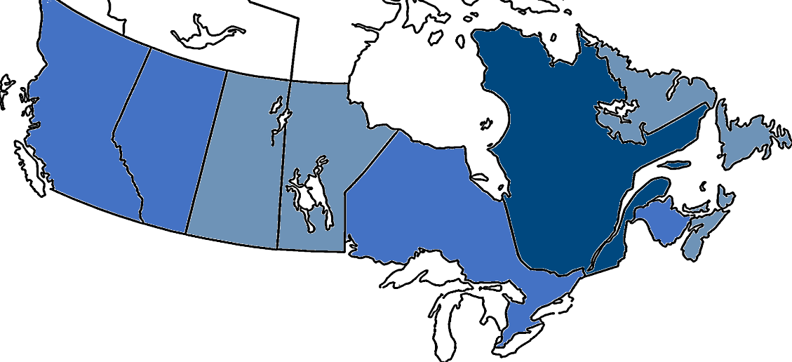
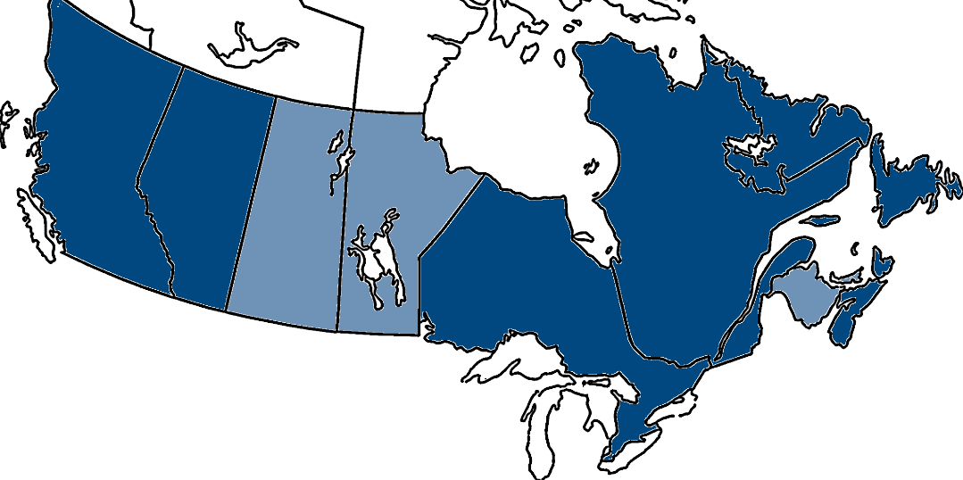
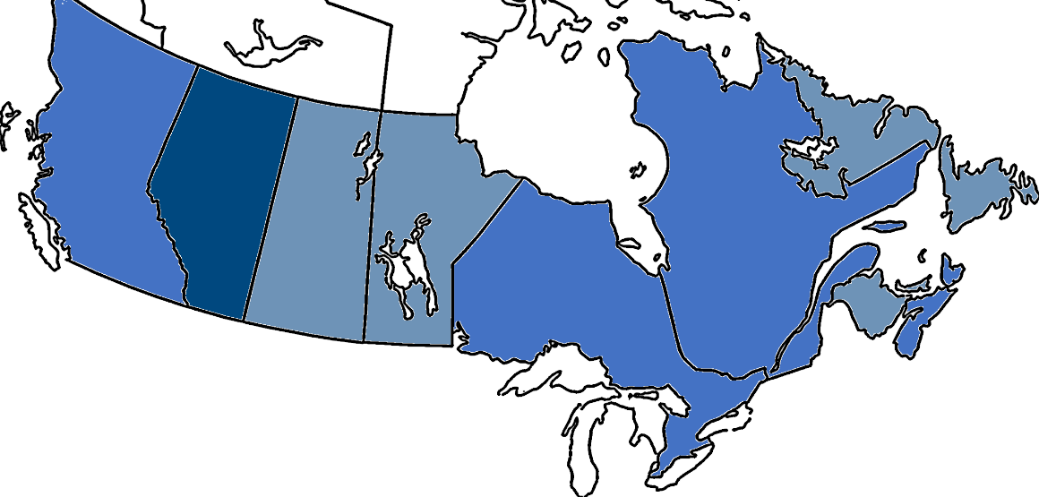
PER CAPITA INVESTMENT, THREE PERIODS
2005‒08
2009‒12
2013‒16
● Less than $1.00
● $1.00‒$1.99
● $2.00 or more

Slide 16
B. Investment by Risk Factors
Four risk factors accounted for 67% of the investment in cancer risk and prevention research in 2016: Infectious Agents, Tobacco, Genetic Susceptibilities and Multiple/General.
Ten of the 15 risk factors had their peak investments in the 2009-2012 period.
Three risk factors, Infectious agents, Tobacco, and Occupational exposures, had their peak investments in the latest four-year period and intervention research was a larger proportion of the Infectious agents and Tobacco investments.
The investment by research focus for each risk factor is presented. The axes vary per risk factor so the magnitude of the bars across charts is not comparable.

Slide 19
INVESTMENT BY RISK FACTOR AND RESEARCH FOCUS, THREE PERIODS ($M)

Slide 20
INVESTMENT BY RISK FACTOR AND RESEARCH FOCUS, THREE PERIODS ($M)

Slide 21
INVESTMENT BY RISK FACTOR AND RESEARCH FOCUS, THREE PERIODS ($M)

Slide 22
INVESTMENT BY RISK FACTOR AND RESEARCH FOCUS, THREE PERIODS ($M)

Slide 23
C. Nominated Principal Investigators
There were 338 PIs who had funding at some point in the last four years. When stratified by risk factors, most worked in the areas of genetic susceptibilities, and infectious agents. Over half of the PIs were funded for work focused on cancer causation.
Although most trainees are supported from diverse sources like provincial or institutional programs, internships or operating grants, a small group of trainees receive awards through the grant peer-review process. Funding from national programs was significantly higher for all time periods and all trainee levels. With some exceptions, the highest investments were in the 2009-12 period.

Slide 25
NOMINATED PRINCIPAL INVESTIGATORS IN 2013‒2016 BY RESEARCH FOCUS (N) [1]
Determinants
N=53
Interventions
N=143
Causes
N=214
N=31
[1] Number of nominated principal investigators with funding in the 2013‒2016 period for at minimum one operating grant, career award or equipment/infrastructure grant that is at least 50% focused on cancer risk and prevention.

Slide 27
Further Information
The brief report, Canada’s Investment in Cancer Risk & Prevention Research, 2005–2016, is available at http://www.ccra-acrc.ca. Production of this report was made possible through collaboration and financial support from the Canadian Partnership Against Cancer Corporation and Health Canada.
This report would not have been possible without the advice provided by Drs. Judy Bray (Canadian Cancer Society), Craig Earle (Canadian Partnership Against Cancer), Jim Hudson (Consultant), and Stephen Robbins (CIHR Institute of Cancer Research).
The impetus for the original cancer risk and prevention analysis came from Dr. Jon Kerner, who was formerly the Senior Scientific Advisor for Cancer Control and Knowledge Translation at the Canadian Partnership Against Cancer.
Questions about this project should be directed to the Canadian Cancer Research Survey Manager at info@ccra-acrc.ca.

Slide 28




 | www.ccra-acrc.ca
 | @CCRAlliance
 | linkedin.com/company/canadian-cancer-research-alliance/
 | info@ccra-acrc.ca

