Slide 1
Canada’s Investment in Translational Cancer Research, 2005–2016

Slide 2
Introduction
The CCRA is an alliance of organizations that collectively fund most of the cancer research conducted in Canada – research that will lead to better ways to prevent, diagnose, and treat cancer and improve survivor outcomes.
Members include federal research funding programs/agencies, provincial research agencies, provincial cancer care agencies, cancer charities, and other voluntary associations.
Member are motivated by the belief that, through effective collaboration, Canadian cancer research funding organizations can maximize their collective impact on cancer control and accelerate discovery for the ultimate benefit of Canadians affected by cancer.
The Executive Office is supported by the Canadian Partnership Against Cancer, funded by Health Canada to work with Canada’s cancer community to implement the Canadian Strategy for Cancer Control to reduce the incidence of cancer, lessen the likelihood of Canadians dying from cancer, and enhance the quality of life of those affected by cancer. The Partnership is committed to enhancing the cancer research environment in Canada through its support of the CCRA and CCRA’s role in coordinating the cancer research funding system. As a member and funder of the CCRA, the Partnership collaborates with other member organizations to enable the strategy for cancer research in Canada.

Slide 3
Why report on this investment?
There is increasing emphasis on identifying ways to “translate” research and accelerate the speed at which the public start to benefit from research advances.
Canada’s cancer research funders are interested in identifying gaps and potential bottlenecks to translational research as well as prospective solutions that will improve the implementation of innovative findings from “bench to bedside.”
For the purposes of this report, translational research refers to research that confirms and advances discoveries into tangible modalities (pre-clinical) and tests modalities in the clinical (clinical). It excludes implementation research, which is designed to transfer clinical findings to practice settings and communities.
3

Slide 4
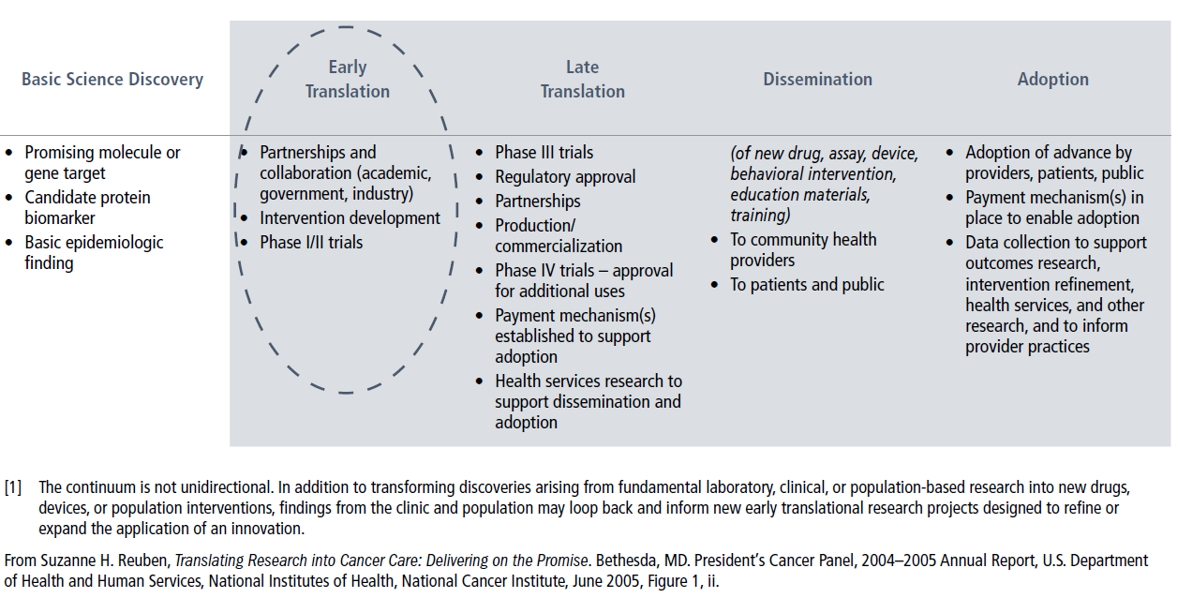
Research Translation Continuum [1]
4

Slide 5
Methodology
The Canadian Cancer Research Survey (CCRS) was the primary data source. This database contains over 22,000 research projects funded by 42 governmental and voluntary sector organizations/programs for years 2005 to 2016.
Projects coded to CSO categories, Early detection, diagnosis and prognosis and Treatment, were all included and coded to the appropriate modality. Prevention and Cancer survivorship research was also included when the research involved a specific modality. Projects were classified using the TRWG-adopted framework on the following slide.
Funding for major initiatives that supported networks or platforms for translational research were also included and stratified by modality category, not specific modality.
Of note, data from the National Research Council Canada was excluded from the analysis because no new data was received for years 2011 to 2015 and this affected the analysis when stratified by time periods.
5

Slide 6
6

Slide 7
Reporting Conventions
“Cancer research investment” refers to the direct funding of research projects that were administered by organizations contributing data to the survey. All projects had received some form of peer review.
Investment for each project was based on a prorated calculation that assumes project dollars were paid out in equal monthly instalments in accordance with project start and end dates. Project funding was calculated for the period January 1, 2005 to December 31, 2016 and analyzed by three four-year periods (i.e., 2005‒08, 2009‒12, and 2013‒16).
Project budgets are weighted to reflect the extent of relevance to translational cancer research and allocated to the relevant modality in the framework.
8

Slide 8
Caveats
Research undertaken by industry is not part of the CCRS and likely accounts for large investments in early translational research, particularly drug research. Hospital foundations and cancer research funders from outside of Canada are also funding sources for early translational research projects not captured in the report.
Investment figures for British Columbia may under-represent the early translational research investment for the province because the BC Cancer Agency did not contribute data to the CCRS during the reporting period.
Project classification is only as good as the descriptions of the research provided by the funding organizations.
9

Slide 9
A1. Overall Investment
During the decade of 2005 to 2016, a total of $2.3 billion was invested in early translational cancer research. This represents nearly 40% of the overall investment in cancer research. There were 8,979 projects with at least some translational research component.
The substantive rise in the investment in 2009 was attributable to the ramp-up of the Ontario Institute for Cancer Research (OICR) as well as increased investment in programs for major initiatives administered by the Canada Foundation for Innovation (CFI).
Although the investment followed the general overall cancer research trend, the translational research investment was sustained, representing 49% of overall cancer research investment in 2016 up from 34% in 2005.
The growth in investment from 2005–08 to 2013–16 was largely the result of increased investment in agents (drugs & biologics) and biospecimen-based risk assessment (biomarkers).
10

Slide 10
A2. Overall Investment
For all modalities, there were significant increases in the investment from 2005 to 2016, although they each had unique patterns in terms of peak investments.
Across the board, the increase was largely in research focused on the pre-clinical phase, although the investment in clinical research also grew for all modalities and was highest in 2013‒16 period.
The largest investment in terms of major initiatives was for interventive modalities, with much of this investment focused on supporting drug research.
Although not captured in the investment figures, biorepositories are key to supporting translational cancer research.
11

Slide 11
12

Slide 13
13

Slide 15
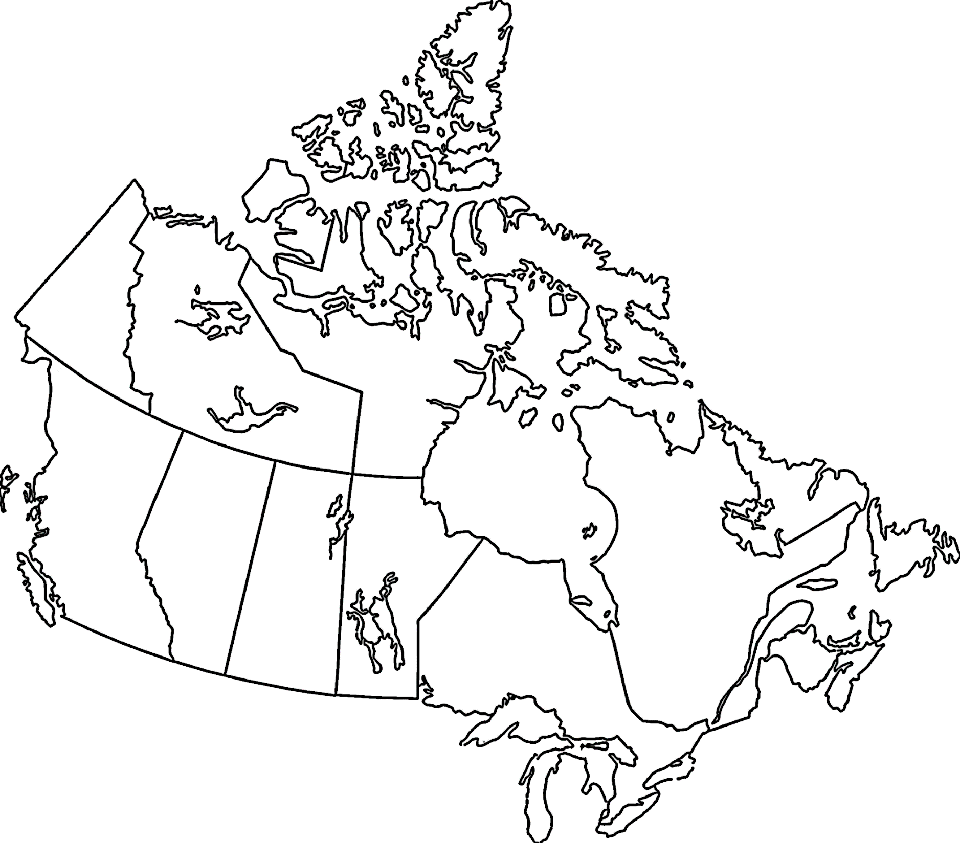

Slide 16
B. Organization-specific Investment
40% of the total translational investment (including major initiatives) came from the Federal government sector. Only the investment from the voluntary sector (charities and non-profit associations), however, showed growth from the first to the third four-year period.
All organizations covered in the CCRS had some investment in translational research, be it research funding or supporting infrastructure such as biorepositories. However, the modality-specific investment was largely from a few funding organizations. In fact, nearly 60% of the overall 12-year investment was made by: Canadian Institutes of Health Research (CIHR), Ontario Institute for Cancer Research (OICR), Canada Foundation for Innovation (CFI), Canadian Cancer Society (CCS), and The Terry Fox Research Institute (TFRI). To access information on the top funders for each modality, please consult our interactive dashboards.
Translational research investment as a proportion of the overall 12-year cancer research investment was highest for the Natural Sciences and Engineering Research Council (NSERC), Canadian Association of Radiation Oncology (CARO), and Pancreatic Cancer Canada.
16

Slide 17
17

Slide 19
C. Site-specific Investment
Breast cancer research represented one-quarter of the total site-specific translational cancer research investment over the 12-year period.
The average annual site-specific early translational cancer research investment exceeded $5M per year for each of the following six cancer groups: breast, prostate, leukemias, brain, lung, and colorectal.
The difference in the translational cancer research investment from the first to the third four-year period was $10M or more for: leukemias ($50M); prostate ($45M); breast ($44M); brain ($32M), pancreas ($15M), non-Hodgkin’s lymphoma ($14M); and ovary ($12M).
There were slight variations in the rankings of site-specific investments when stratified by modality. To access this information, please see our interactive dashboards.
19

Slide 21
D. Nominated Principal Investigators
There were 1,011 nominated principal investigators (PI) with at least one or more operating grant, career award, or equipment grant with a translational research weighting of 100% funded in the 2013‒16 period. Half of these researchers were funded for interventive research, 24% for risk assessment research and the remainder with research in both areas.
Over half of the nominated PIs in the 2013‒16 period were from Ontario or Quebec.
Although most trainees are supported from diverse sources like provincial or institutional programs, internships or operating grants, a small group of trainees receive awards through the grant peer-review process. Over the 12 years, 1,636 trainees received funding for translational research projects. Of these, 50 went on to receive grants as nominated PIs.
The investment in trainee awards grew for both national and regional funders at all levels over the three time periods, although there were some modality-specific variations.
21

Slide 25
E1. Investment by Province
The research investment is based on the provincial affiliation of the nominated principal investigator. Provincial populations were used to normalize the research investment data.
The highest per capita investments for the 12-year period were found in Ontario, British Columbia, and Quebec. Principal investigators (PI) in these provinces were most often the nominated PIs who received funding for major initiatives.
From the first to the latest four-year period, there were increases in the per capita investments for Ontario, Quebec and Alberta.
23

Slide 26
E2. Investment by Province
There were modality-specific differences. In 2013‒16, the per capita investments exceeded the national average for:
  Ontario and B.C. for agents (drugs & biologics)
  Ontario and Nova Scotia for immune response modifiers (immunotherapies)
  Alberta and Ontario for interventive devices (devices)
  Quebec and Ontario for biospecimen-based risk assessment (biomarkers)
  Ontario for image-based risk assessment (imaging)
23

Slide 27
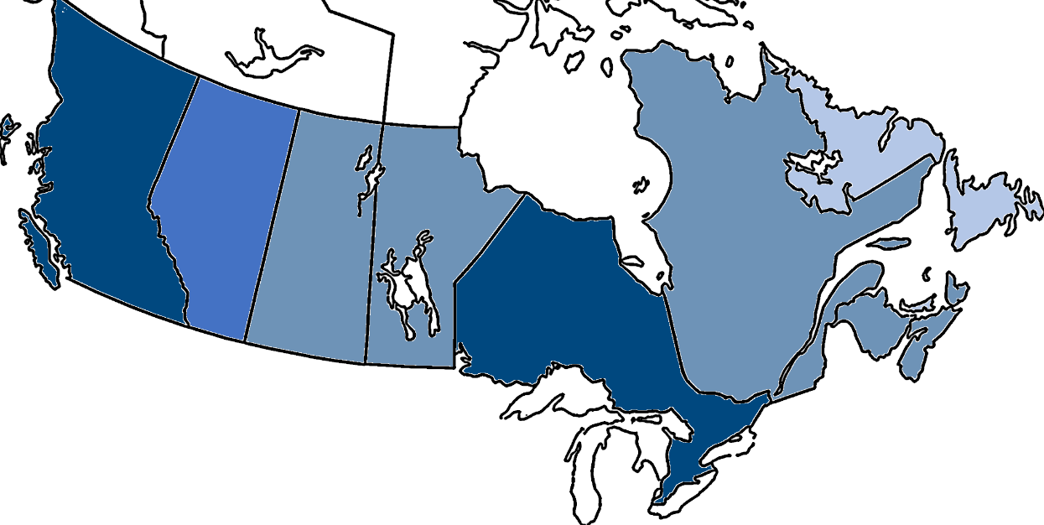
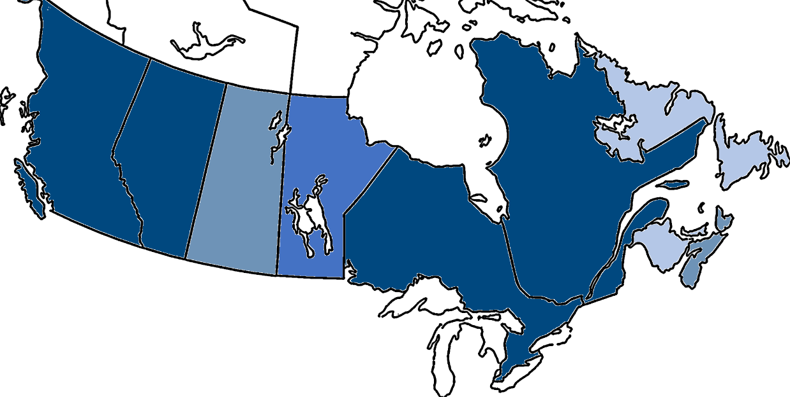
PER CAPITA INVESTMENT, 2005‒08 AND 2013-16
2005‒08
2013‒16
● Less than $1.00
● $1.00‒$2.99
● $3.00‒$4.99
● $5.00 or more

Slide 28
Further Information
A brief electronic report, Canada’s Investment in Translational Cancer Research, 2005–2016, and an interactive dashboard are available at http://www.ccra-acrc.ca. Production of this report was made possible through collaboration and financial support from the Canadian Partnership Against Cancer Corporation and Health Canada.
This report would not have been possible without the advice provided by Drs. Judy Bray (Canadian Cancer Society), Craig Earle (Canadian Partnership Against Cancer), Stuart Edmonds (Prostate Cancer Canada), Stephen Herst (Terry Fox Research Institute), Jim Hudson (Consultant), Anne-Marie Mes-Masson (Institut du cancer de Montréal, CRCHUM), and Stephen Robbins (CIHR Institute of Cancer Research).
The impetus for the original translational research analysis came from Dr. Victor Ling, founding President and Scientific Director of The Terry Fox Research Institute, and recognizes the organization’s pioneering role in support of translational research in Canada.
Questions about this project, should be directed to the Canadian Cancer Research Survey Manager at info@ccra-acrc.ca.
25

Slide 29




 | www.ccra-acrc.ca
 | @CCRAlliance
 | linkedin.com/company/canadian-cancer-research-alliance/
 | info@ccra-acrc.ca

