Slide 2
Challenges
Siloed research activities
Limited data sharing
Slow translation of discoveries
Difficulties attracting and retaining researcher talent
Limited ability to embrace disruptive technologies
Funding constraints
Addressing the challenges in the cancer research environment calls for a unified sense of purpose and the involvement of all related organizations and actors. If we want action to occur in a more coordinated fashion, we need to know where we are going.

Slide 3

The Canadian Strategy for Cancer Control (CSCC) calls for a cancer research vision that unites us all
The refreshed Canadian Strategy for Cancer Control recognizes “the need for the development of a shared vision for Canadian cancer research that moves the country forward.”

Slide 4
The CSCC recognizes research as a key enabler across key priority areas
A stronger emphasis on translational research
Improving access to clinical trials and enhancing the diversity of participants
Raising the global profile of Canadian researchers
Embedding research in care and learning from every patient
Attracting, retaining and supporting researchers

Slide 5
In general, a vision:
Describes what could (should) be but intentionally does not describe the how
Is deliberately high-level
Is enduring—agnostic to today’s challenges or technologies
Needs to be accessible, inclusive and appeal to all stakeholders

Slide 6
Our Vision for Canadian cancer research provides clarity and inspiration. It:
Describes a future ideal state for the Canadian cancer research environment
Aligns the entire research community around commitments that will move the field toward this state
Shows what Canada needs to become if it is to remain a leader in cancer research and deliver impact for patients and populations

Slide 7
Our Vision was informed by extensive engagement of the research community and beyond. The thought leaders we spoke with represented all pillars of health research and the cancer care continuum. A broad swath of people from across the country shared their thoughts on the future of Canadian cancer research.
Cancer research visions for First Nations, Inuit, and Métis will be co-created in separate processes led by Indigenous research leaders.

Slide 8



Our Vision was crafted from key learnings that speak to:
the trends to which Canada needs to respond
the strengths and opportunities Canada must amplify
the collaborative spirit needed to achieve success

Slide 9
Learning #1: Canadian cancer research needs to be inclusive.
The role of the individual in research is evolving and will continue to grow.
Our willingness to collaborate is a key strength and will become even more important.
Our population is diverse and we need to promote health and equity for all.

Slide 10
Learning #2: Canadian cancer research needs to be bold.
Technologies will advance our ability to mine and interpret data at an unprecedented rate and scale.
We are building from a strong foundation of cutting-edge research.
We need new approaches to collaboration, data sharing and translation of discoveries.

Slide 11
Learning #3: Canadian cancer research needs to be more integrated with the cancer control system.
Healthcare systems and how we perform research will become increasingly dynamic.
Our cancer research infrastructure needs to be better aligned and integrated.
We need urgent translation and integration of discoveries into better cancer control.

Slide 12

Every person
in Canada is part of
a bold movement
to push the frontiers of cancer research and translate
all promising discoveries
into maximum health
and wellbeing.

Slide 13
While the Vision is broad in scope, it is also deeply personal. We hope that every person in Canada feels included in this Vision and inspired to contribute to cancer research in ways that reflect Canada’s diversity and our shared desire to advance health equity.
Every person
in Canada is part of
a bold movement
to push the frontiers of cancer research and translate
all promising discoveries
into maximum health
and wellbeing.

Slide 14
Every person
in Canada is part of
a bold movement
to push the frontiers of cancer research and translate
all promising discoveries
into maximum health
and wellbeing.
We need cancer research to become a bold social movement, creating a sense of urgency and uniting people in an alliance that demands solutions from a system capable of delivering positive change.

Slide 15
We believe this change will require equally inspirational science. The Canadian cancer research community must be the trailblazers who are embracing technological advances, tackling cancer’s most complex challenges and leading the global community in the journey to control cancer.
Every person
in Canada is part of
a bold movement
to push the frontiers of cancer research and translate
all promising discoveries
into maximum health
and wellbeing.

Slide 16
Every person
in Canada is part of
a bold movement
to push the frontiers of cancer research and translate
all promising discoveries
into maximum health
and wellbeing.
We also believe that no promising discovery from our efforts—or research efforts anywhere in the world—should be wasted. We must capture their full value in advancing science and achieving impact for people and health systems.

Slide 17
Every person
in Canada is part of
a bold movement
to push the frontiers of cancer research and translate
all promising discoveries
into maximum health
and wellbeing.
To get there, research needs to be fully integrated into a dynamic and adaptive healthcare system and focused on maximizing people’s social, mental, emotional and physical health and wellbeing across the prevention and end-of-life continuum.

Slide 18

Our Vision requires three commitments

Slide 19

Commitment 1: We need Activated Populations
Every person in Canada understands that cancer research is about, for, and with them.
Cancer is both a universal experience—and a deeply personal one. Tackling cancer requires the active engagement of every person in Canada.

Slide 20

Commitment 2: We need Intrepid Science
The Canadian approach to cancer research is leading the way.
Cancer research and technology are advancing more rapidly than at any point in history. We need a research culture that takes risks and evinces the courage to ask not just why, but why not.

Slide 21

Commitment 3: We need Living Innovation
Cancer research is at the heart of Canada’s dynamic cancer control system.
The translation of cancer knowledge and innovation is increasingly adaptive, iterative and organic. We need a research system that drives knowledge and innovation efficiently into practice and transforms real-world insights into solutions.

Slide 22
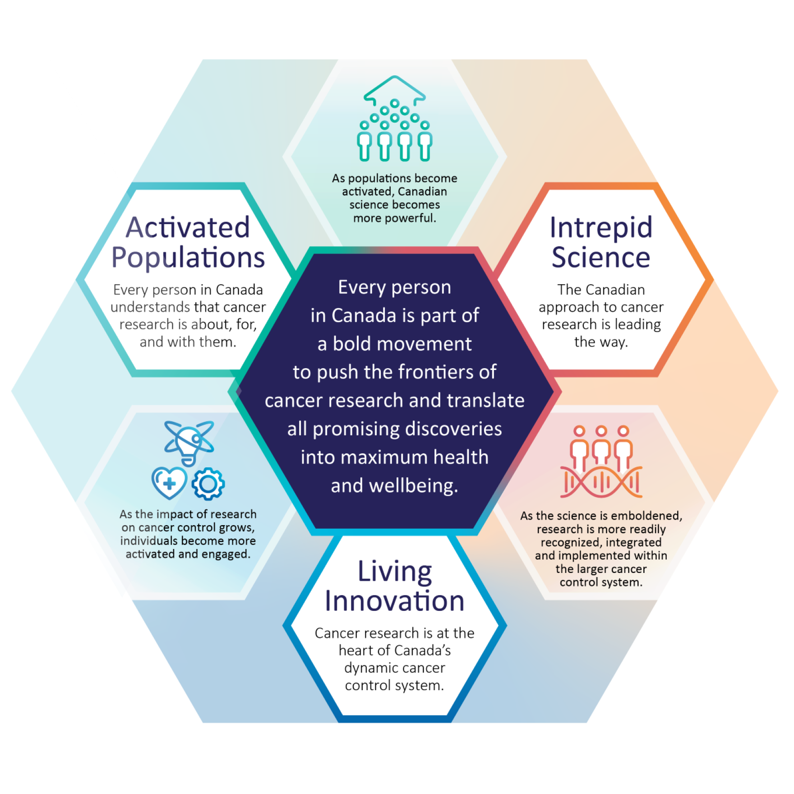
Together, these commitments form a virtuous, enduring cycle to move us closer to the Vision

Slide 23




Our Vision will:
Encourage and solidify partnerships with patients, the public and international partners, and motivate systems to translate findings.
Support engagement with government stakeholders by distinguishing the cancer research ecosystem and creating urgency around the need for funding.
Attract and retain talent in the cancer research field in Canada and encourage scientists to think long-term and take risks.
Contribute to our ability to secure funding and resources by demonstrating that we work together in pursuit of common goals.

Slide 24
Your Role
Canada’s Vision for Cancer Research belongs to everyone and every person is a valued partner. Consider your place within this Vision and how you can most effectively contribute.
We ask everyone in Canada to integrate the essence of this Vision into their own strategic plans, research advocacy, or cancer control work, and to join together to advance an activated, intrepid, and living system of cancer research, innovation, and impact.

