Slide 1
Canada’s Research Investment in
Childhood and Adolescent Cancers, 2005–2019

Slide 2
Introduction
The CCRA is an alliance of organizations that collectively fund most of the cancer research conducted in Canada – research that will lead to better ways to prevent, diagnose, and treat cancer and improve survivor outcomes.
Members include federal research funding programs/agencies, provincial research agencies, provincial cancer care agencies, cancer charities, and other voluntary associations.
Member are motivated by the belief that, through effective collaboration, Canadian cancer research funding organizations can maximize their collective impact on cancer control and accelerate discovery for the ultimate benefit of Canadians affected by cancer.
The Executive Office is supported by the Canadian Partnership Against Cancer, funded by Health Canada to work with Canada’s cancer community to implement the Canadian Strategy for Cancer Control to reduce the incidence of cancer, lessen the likelihood of Canadians dying from cancer, and enhance the quality of life of those affected by cancer. The Partnership is committed to enhancing the cancer research environment in Canada through its support of the CCRA and CCRA’s role in coordinating the cancer research funding system. As a member and funder of the CCRA, the Partnership collaborates with other member organizations to enable the strategy for cancer research in Canada.

Slide 3
Why report on this investment?
Research investment in childhood and adolescent cancers may be qualitatively different from the investment in other cancer research for the following reasons:
  the substantial biological and clinical heterogeneity of pediatric cancers together with their low incidence makes the discovery of disease causation challenging
  the induction period for the causes of most adult cancers is thought to be as much as 20-30 years; this is not the case for childhood and adolescent cancers
  survivorship and health services research are crucial given the growing number of childhood and adolescent cancer survivors, many of whom have significant long-term health and psychosocial challenges due to their cancer or treatment
  the relatively small number of children and adolescents affected by cancer means that multi-centre and multi-disciplinary research is essential

Slide 4
Methodology
The Canadian Cancer Research Survey (CCRS) was the primary data source. This is a database of over 27,000 research projects funded by 43 governmental and voluntary sector organizations for years 2005 to 2019.
Projects being conducted at pediatric centres, supported by programs dedicated to pediatric cancer research, or with relevant keywords in their titles and project descriptions were identified and then reviewed for inclusion. 1,853 projects were selected for inclusion and this represented projects funded by 36 of the 43 organizations/programs captured in the CCRS.

Slide 5
Reporting Conventions
“Cancer research investment” refers to the direct funding of research projects that were administered by organizations contributing data to the survey. All projects had received some form of peer review.
Project budgets were weighted in terms of the relevance of the project to childhood and adolescent cancers (ages 0-19). For example, the budget for a project that focused on palliative care for both child and adult cancer survivors was weighted at 50%.
Institutional affiliation of the nominated principal investigator (PI) was used for analyses based on geography (province).

Slide 6
Project Classification
The Common Scientific Outline (CSO), used by the International Cancer Research Partnership (ICRP), was the principal framework used to classify research areas. It is organized according to six broad areas of scientific interest: 1-Biology, 2-Etiology, 3-Prevention, 4-Early detection, diagnosis & prognosis, 5-Treatment, and 6-Cancer control, survivorship & outcomes.
The International Classification of Childhood Cancer, Third Edition (ICCC-3) was used for the cancer site groupings. ICCC-3 is based on tumour structure and was developed to reflect the differences in childhood from adult-onset cancers.
Each project was also assigned a single CIHR research pillar: I – Biomedical; II – Clinical; III – Health Systems and Health Services; and IV - Social, Cultural, Environmental, and Population Health Research. Projects that had a mix of biomedical and clinical components were coded to pillar II, Clinical.

Slide 7
Caveats
Appropriate selection of projects for inclusion and project coding are highly dependent on the quality of the research project descriptions.
The report is estimated to cover about two-thirds of the total peer-reviewed research funding for the 2005 to 2019 period.
Omitted sources include funding:
  for the Cancer in Young People in Canada (CYP-C) Data Tool, a population-based registry of all cases of pediatric cancer diagnosed and treated at the 17 tertiary pediatric oncology centres in Canada, which serves as an important platform for research (see https://health-infobase.canada.ca/data-tools/cypc/)
  from foundations associated with pediatric facilities and other Canadian-based charities, including endowed chairs, and BC Cancer Agency and its Foundation
  for clinical trials sponsored by cooperative groups in the U.S., Europe, and Australia
  from industry

Slide 8
A1. Overall Investment
Research investment in childhood and adolescent cancers more than tripled, from $9.7M in 2005 to $36.1M in 2019. This investment represented 7% of the overall cancer research investment in 2019.
Much of the impetus in funding in the latest five-year period (2015-2019) was the result of non-targeted funding programs – that is, from funding programs that were not specific to childhood and adolescent cancers.
In 2019, $20.7M was invested by federal government programs/agencies, which represented 57% of the overall research investment in childhood and adolescent cancers. This was largely the result several large-scale pediatric-related genomics research projects, which initiated in 2018.

Slide 9
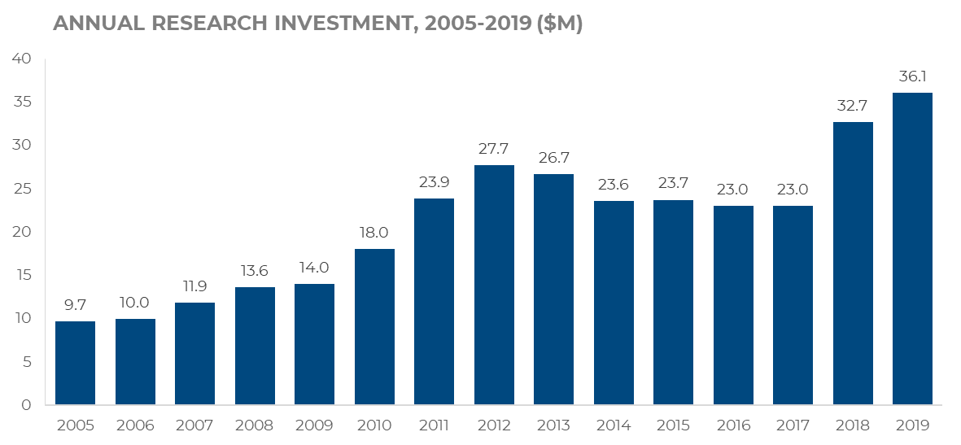

Slide 10
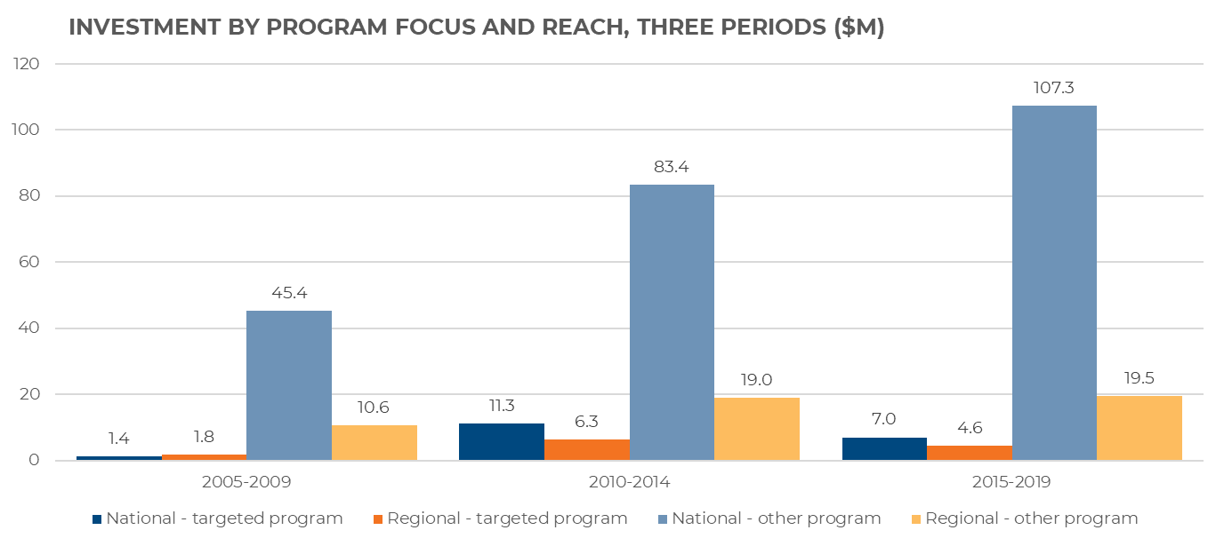

Slide 11
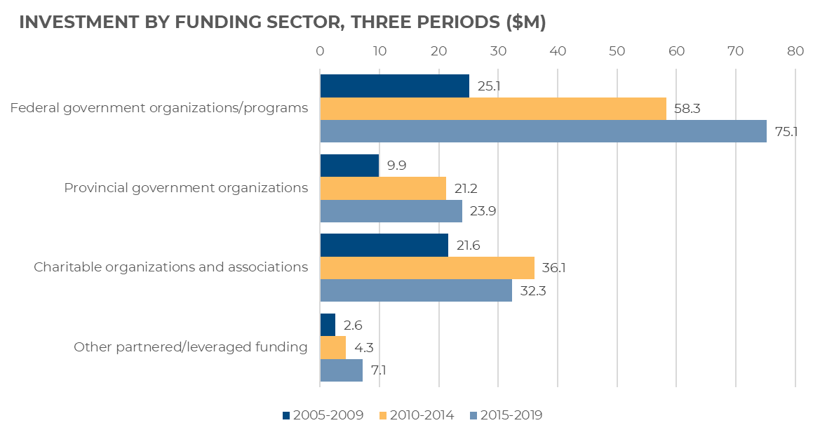

Slide 12
A2. Overall Investment
Four of every ten dollars invested in research in 2019 on childhood and adolescent cancers came from the Canadian Institutes of Health Research (CIHR). In terms of CIHR’s overall cancer research investment, the proportion related to childhood and adolescent cancers rose from 3.7% in 2005 to 8.8% in 2019.
Other funders/programs with 15-year investments in excess of $8M were: Canadian Cancer Society (CCS), Ontario Institute for Cancer Research (OICR), Genome Canada, The Terry Fox Research Institute (TFRI), The Cole Foundation, Fonds de recherche du Québec – Santé (FRQS), and the Canada Research Chairs Program.
In terms of funding mechanisms, operating grants formed the largest share of the investment. For all three time periods, three-quarters of the operating grant investment was in the biomedical research pillar.

Slide 14
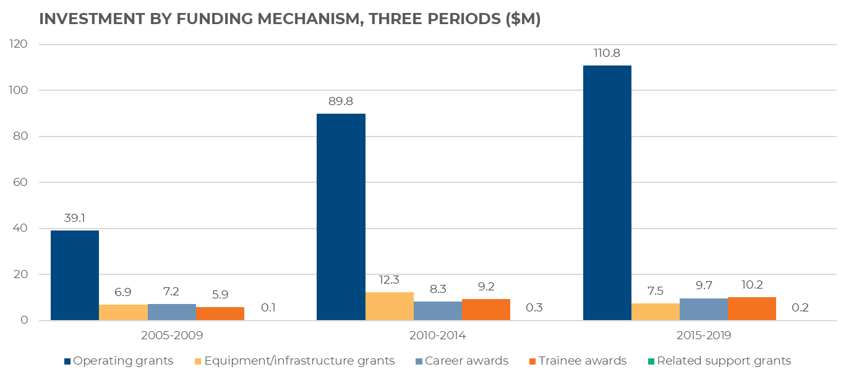

Slide 15
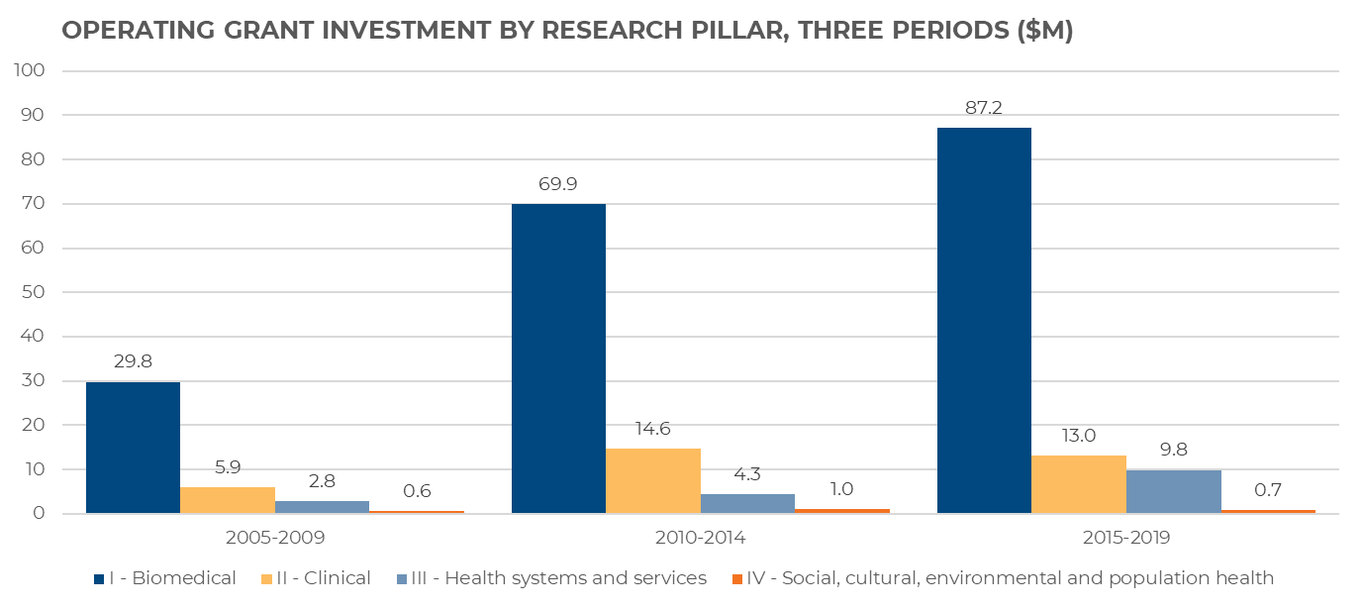

Slide 16
B. Investment by AREAS OF SCIENCE
Research focused on cancer biology represented a shrinking proportion of the annual investment in childhood and adolescent cancers over the 15 years, consistent with the overall cancer research investment trend.
Investment in the Early detection, diagnosis & prognosis category had the greatest increase from the first to the third five-year period (more than six-fold) and reflected increased investment on research focused on biomarker discovery to aid in precision medicine approaches.
The investment in treatment research more than tripled from the first to the third period.

Slide 17
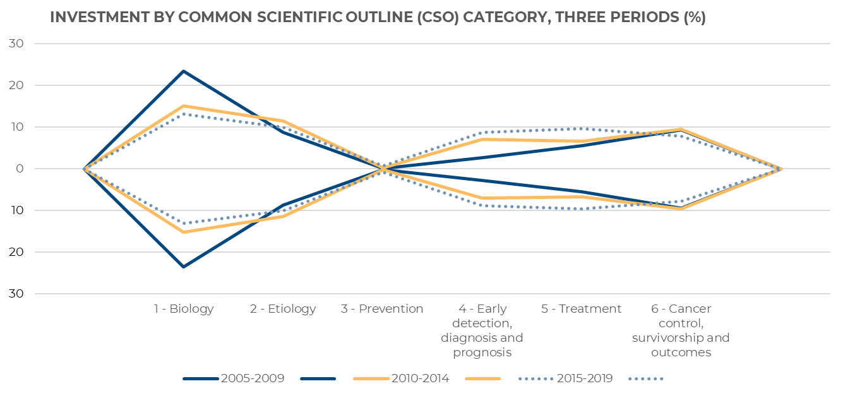

Slide 18
C. Investment by Cancer sites
Over 80% of the childhood and adolescent cancer research investment was focused on specific cancers.
Much of the overall increased investment in childhood and adolescent cancer research was the result of increased investments in research on central nervous system neoplasms (which includes cancers of the brain and spinal cord).
The research investment in leukemias rose from the first to the second time period but remained constant for the most recent time period.
Research on soft tissue sarcomas had a notable increased investment in the latest time period.

Slide 20
D. Nominated Principal Investigators
Over the 15 years, there were 402 nominated principal investigators (PIs) funded for research projects on childhood and adolescent cancers. This number represents nominated PIs who were funded for at least one operating grant, equipment grant, and/or career award focused on childhood and adolescent cancers.
From the first time period to the second and third, the number of PIs with active research projects increased. 62 PIs had active research funding at some point in all three periods.
Many nominated PIs with active research projects in the 2015-2019 period worked at institutions in Ontario and Quebec, the most populous provinces.
Although most trainees are supported from diverse sources like provincial or institutional programs, internships or operating grants, a small group of trainees receive awards through the grant peer-review process. From 2005 to 2019, 507 trainees were funded for research projects that were relevant to childhood and adolescent cancers. The investment in graduate and post-doctoral awards through regional funding programs and graduate awards through national funding programs increased over the time periods, suggesting a growing base of researchers across the country.

Slide 21
2015-2019
N=244
2010-2014
N=242
N=62
2005-2009
N=161

Slide 22
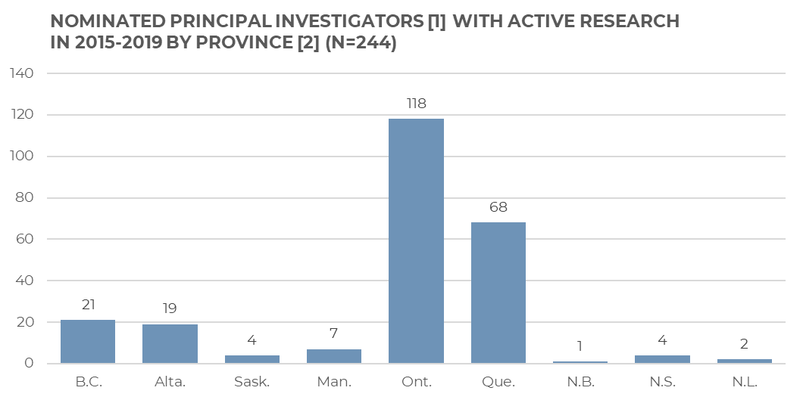

Slide 23
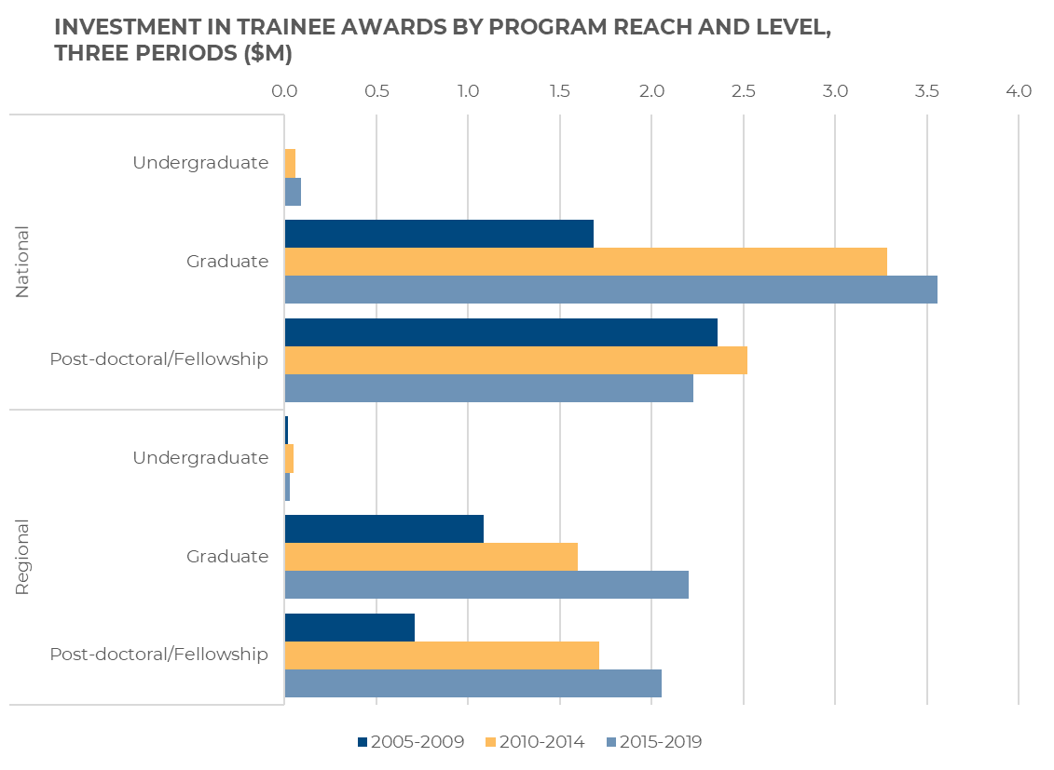

Slide 24
Further Information
The brief report, Canada’s Research Investment in Childhood and Adolescent Cancers, 2005–2019, is available at http://www.ccra-acrc.ca. Production of this report was made possible through collaboration and financial support from the Canadian Partnership Against Cancer Corporation and Health Canada.
This report would not have been possible without the advice provided by Mr. Randy Barber (C¹⁷ Council), Ms. Kathy Brodeur-Robb (C¹⁷ Council), Mr. Jay Onysko (Public Health Agency of Canada) and Dr. Leah Young (C¹⁷ Council).
Dr. Paul Grundy and Ms. Kathy Brodeur-Robb played instrumental roles in the conceptualization of the initial report on this topic, published in 2009.
Questions about this project, should be directed to the CCRA Program Manager at info@ccra-acrc.ca.

Slide 25




 | www.ccra-acrc.ca
 | @CCRAlliance
 | linkedin.com/company/canadian-cancer-research-alliance/
 | info@ccra-acrc.ca

