Slide 1
Canada’s Investment in Cancer Risk and Prevention Research, 2005–2019

Slide 2
Introduction
The CCRA is an alliance of organizations that collectively fund most of the cancer research conducted in Canada – research that will lead to better ways to prevent, diagnose, and treat cancer and improve survivor outcomes.
Members include federal research funding programs/agencies, provincial research agencies, provincial cancer care agencies, cancer charities, and other voluntary associations.
Member are motivated by the belief that, through effective collaboration, Canadian cancer research funding organizations can maximize their collective impact on cancer control and accelerate discovery for the ultimate benefit of Canadians affected by cancer.
The Executive Office is supported by the Canadian Partnership Against Cancer, funded by Health Canada to work with Canada’s cancer community to implement the Canadian Strategy for Cancer Control to reduce the incidence of cancer, lessen the likelihood of Canadians dying from cancer, and enhance the quality of life of those affected by cancer. The Partnership is committed to enhancing the cancer research environment in Canada through its support of the CCRA and CCRA’s role in coordinating the cancer research funding system. As a member and funder of the CCRA, the Partnership collaborates with other member organizations to enable the strategy for cancer research in Canada.

Slide 3
Why report on this investment?
On the basis of present knowledge, between a third to a half of cancers may be preventable. Understanding the risk factors associated with cancer is important to the development of strategies to prevent cancer.
While much is known about how to prevent cancer, research is needed to develop and test effective interventions at the structural, organizational, and individual levels.
Primary cancer prevention is a critical component to stemming the anticipated rise in the number of cancer cases (largely due to population growth and the aging Canadian population) in the coming decades and is vital to lowering the personal, social and economic costs associated with cancer.

Slide 4
Methodology
The Canadian Cancer Research Survey (CCRS) was the primary data source. This is a database of over 27,000 research projects funded by 43 governmental and voluntary sector organizations for years 2005 to 2019.
3,355 projects were selected based on coding criteria and exclusion criteria (projects were funded by 41 of the 43 organizations).
Selected projects were classified according to the three-dimensional cancer risk and prevention research “cube,” which was developed specifically for this work.

Slide 5
Cancer Risk and Prevention Cube

Slide 6
Reporting Conventions
“Cancer research investment” refers to the direct funding of research projects that were administered by organizations contributing data to the survey. All projects had received some form of peer review.
Investment for each project was based on a prorated calculation that assumes project dollars were paid out in equal monthly instalments in accordance with project start and end dates. Project funding was calculated for the period January 1, 2005 to December 31, 2019.
Data were analyzed for three five-year periods: 2005–09, 2010–14, and 2015–19.
Budgets of projects that focused on more than cancer prevention were adjusted to reflect the extent of the cancer prevention focus.

Slide 7
Caveats
The report does not include the full investment in research on chronic disease risk and prevention – the focus here is on cancer.
Investments in intramural cancer prevention research being conducted by federal, provincial and municipal governments/agencies or by universities, hospitals, cancer centres, schools, and community organizations were not captured.
Investment figures for British Columbia may under-represent the cancer prevention investment for the province because the BC Cancer Agency and its Foundation did not contribute data to the CCRS during the reporting period.
Investments by industry are not part of the CCRS unless they are partnered dollars for projects funded by data contributors.

Slide 8
A1. Overall Investment
A total of $806.4M was invested in cancer risk and prevention research from 2005 to 2019. This represented 11% of the overall cancer research investment captured in this report.
Nine funders accounted for 73% of the 15-year investment. The Canadian Institutes of Health Research (CIHR) was the major funder each year and accounted for 30% of the overall 15-year investment. The Canadian Cancer Society (CCS) invested the second highest amount each year, accounting for 14% of the overall 15-year cancer risk and prevention investment.
Investment in CanPath (Canadian Partnership for Tomorrow’s Health) by the Canadian Partnership Against Cancer and provincial funders formed a large proportion of the overall investment. As this infrastructure has moved from ‘build’ to ‘maintenance’ mode there has been a corresponding drop in the investment. Likewise, major investments in infrastructure projects administered by the Canada Foundation for Innovation also concluded in the mid-point of the 15 years.

Slide 11
A2. Overall Investment
Although the investment in intervention research was lower in 2019 than in the years during the middle part of the 15-year period, it represented a higher portion of the investment in the 2015-2019 period.
Large investments in infrastructure that concluded before the last five year period shifted investment downward for research focused on cancer causation and research focused on prevention interventions.
The site-specific investment comprised nearly 60% of the overall investment. The investment by specific cancer sites varied by time period, with significant drops in the investment in breast and colorectal cancers.
The overall cancer risk and prevention research per capita investment was $1.04 in 2019. Per capita rates were variable from period to period, with the decreases in funding for the founder provincial cohorts of CanPath.

Slide 16
B. Investment by Risk Factors
Across all 15 years, the research investment was highest for research focused on genetic susceptibilities, infectious agents, and tobacco. In 2019, the distribution shifted slightly so that infectious agents (21%) surpassed genetic susceptibilities (20%). Tobacco represented 15% of the 2019 investment.
Cancer risk and prevention research on alcohol represented less than 1% of the investment (all years). A recent report released in the Lancet Oncology estimated that 4% of new cancer cases globally were attributable to alcohol consumption.
The investment by research focus for each risk factor is presented.

Slide 17
15-year investment by risk factor (%)
Activity level, body composition & metabolism, $28.2M
Multiple/general, $176.5M
Contaminants in the air, water & soil, $40.7M
Physiological susceptibilities, $11.9M
Hormones, $10.1M
Infectious agents, $117.7M
Diet & nutrition, $37.7M
Tobacco, $82.6M
Occupational exposures, $22.8M
Treatment/diagnostics, $14.2M
Gene-environment interactions, $76.0M
Ethnicity, sex & social environ-ment, $22.7M
Genetic susceptibilities, $144.5M
Precursor lesions, $16.7M
Alcohol, $3.8M

Slide 18
investment by risk factor, Three periods ($M)

Slide 19
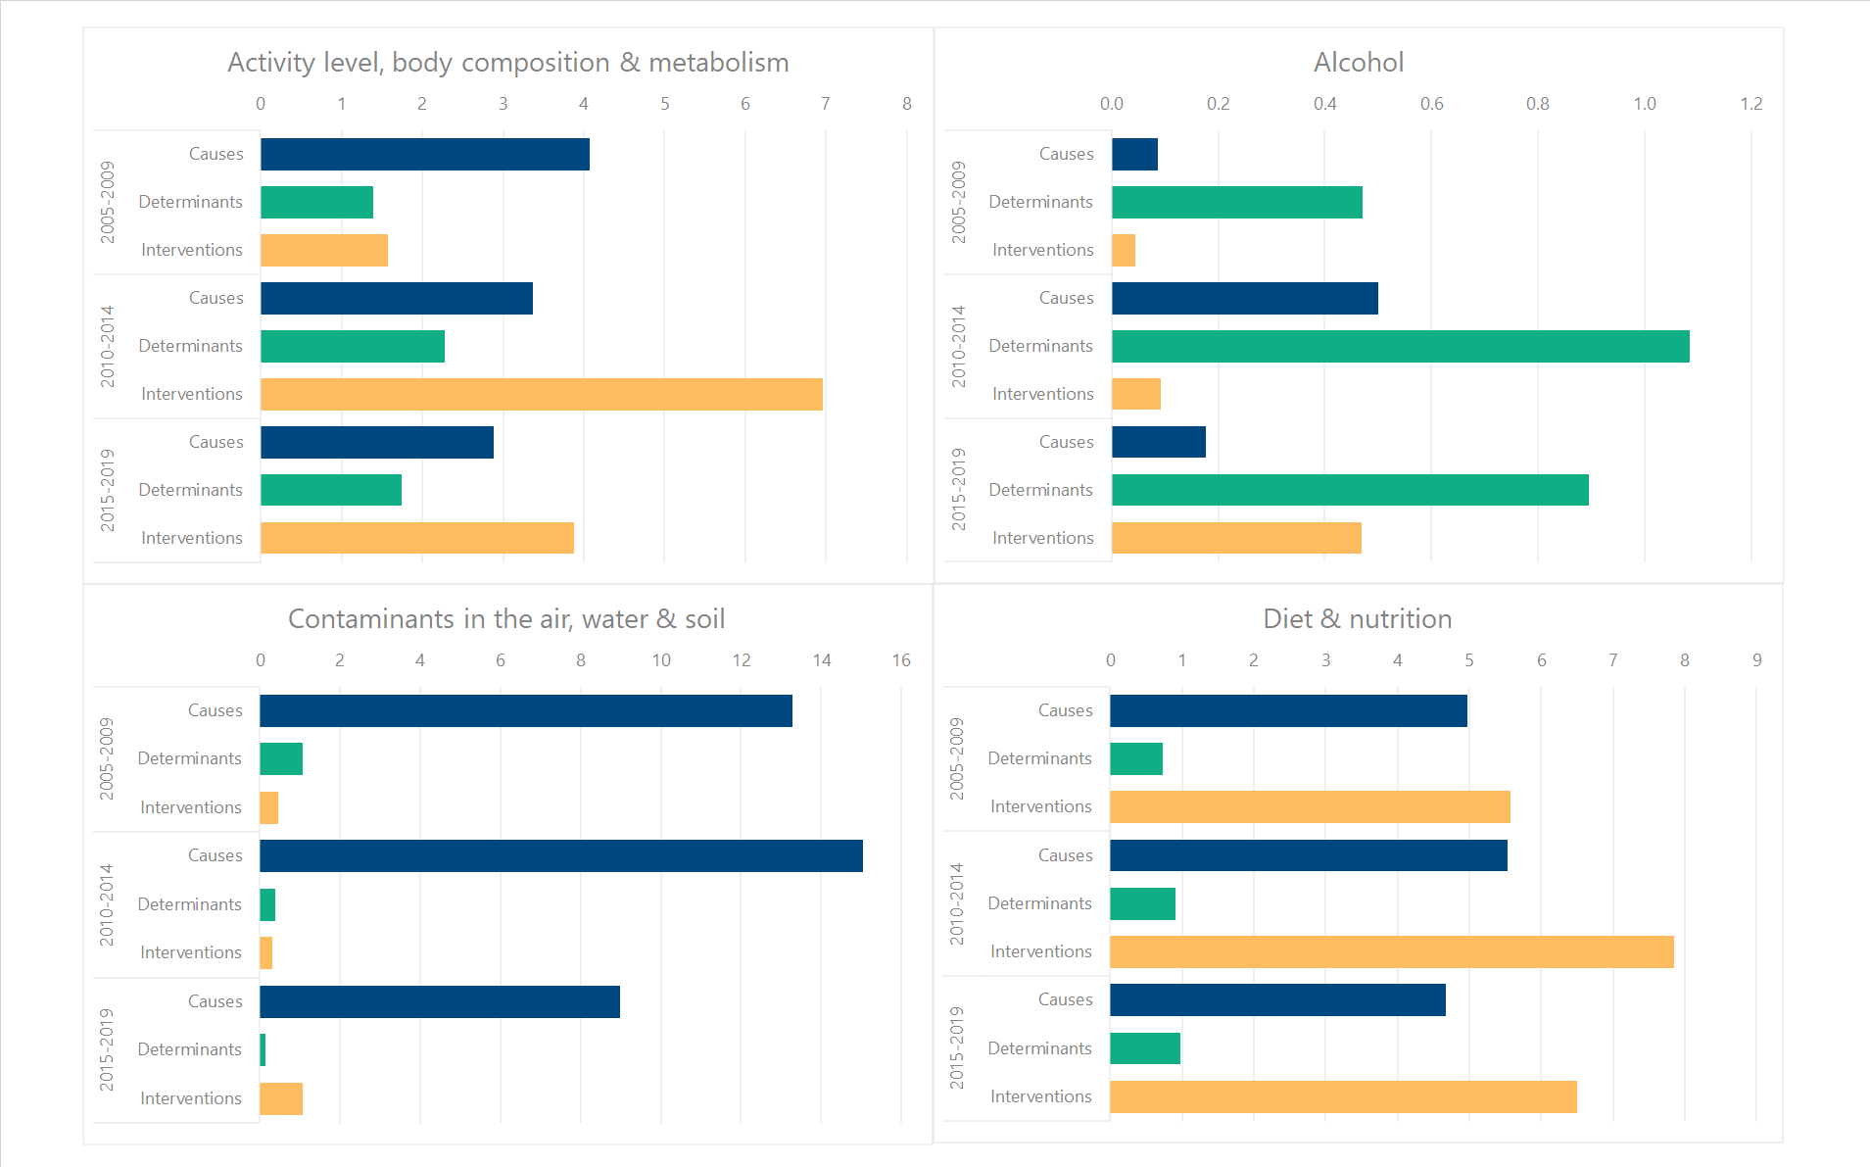
INVESTMENT BY RISK FACTOR AND RESEARCH FOCUS, THREE PERIODS ($M)
The axes vary per risk factor so the magnitude of the bars across charts is not comparable.

Slide 20
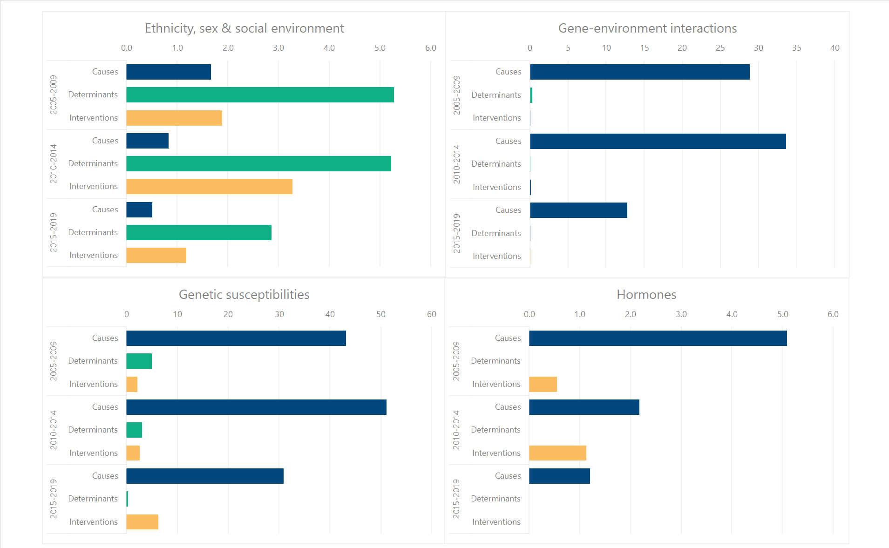
INVESTMENT BY RISK FACTOR AND RESEARCH FOCUS, THREE PERIODS ($M)
The axes vary per risk factor so the magnitude of the bars across charts is not comparable.

Slide 21
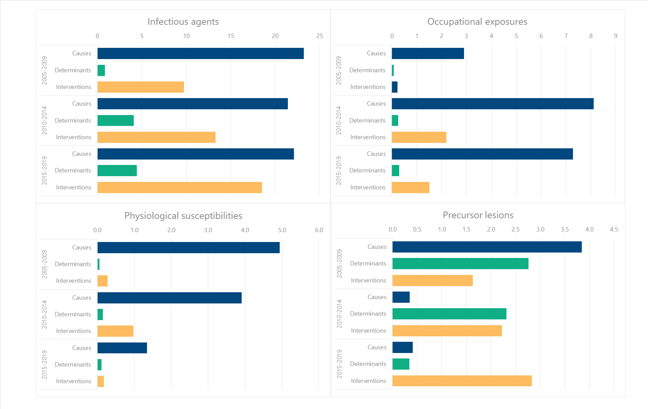
INVESTMENT BY RISK FACTOR AND RESEARCH FOCUS, THREE PERIODS ($M)
The axes vary per risk factor so the magnitude of the bars across charts is not comparable.

Slide 22
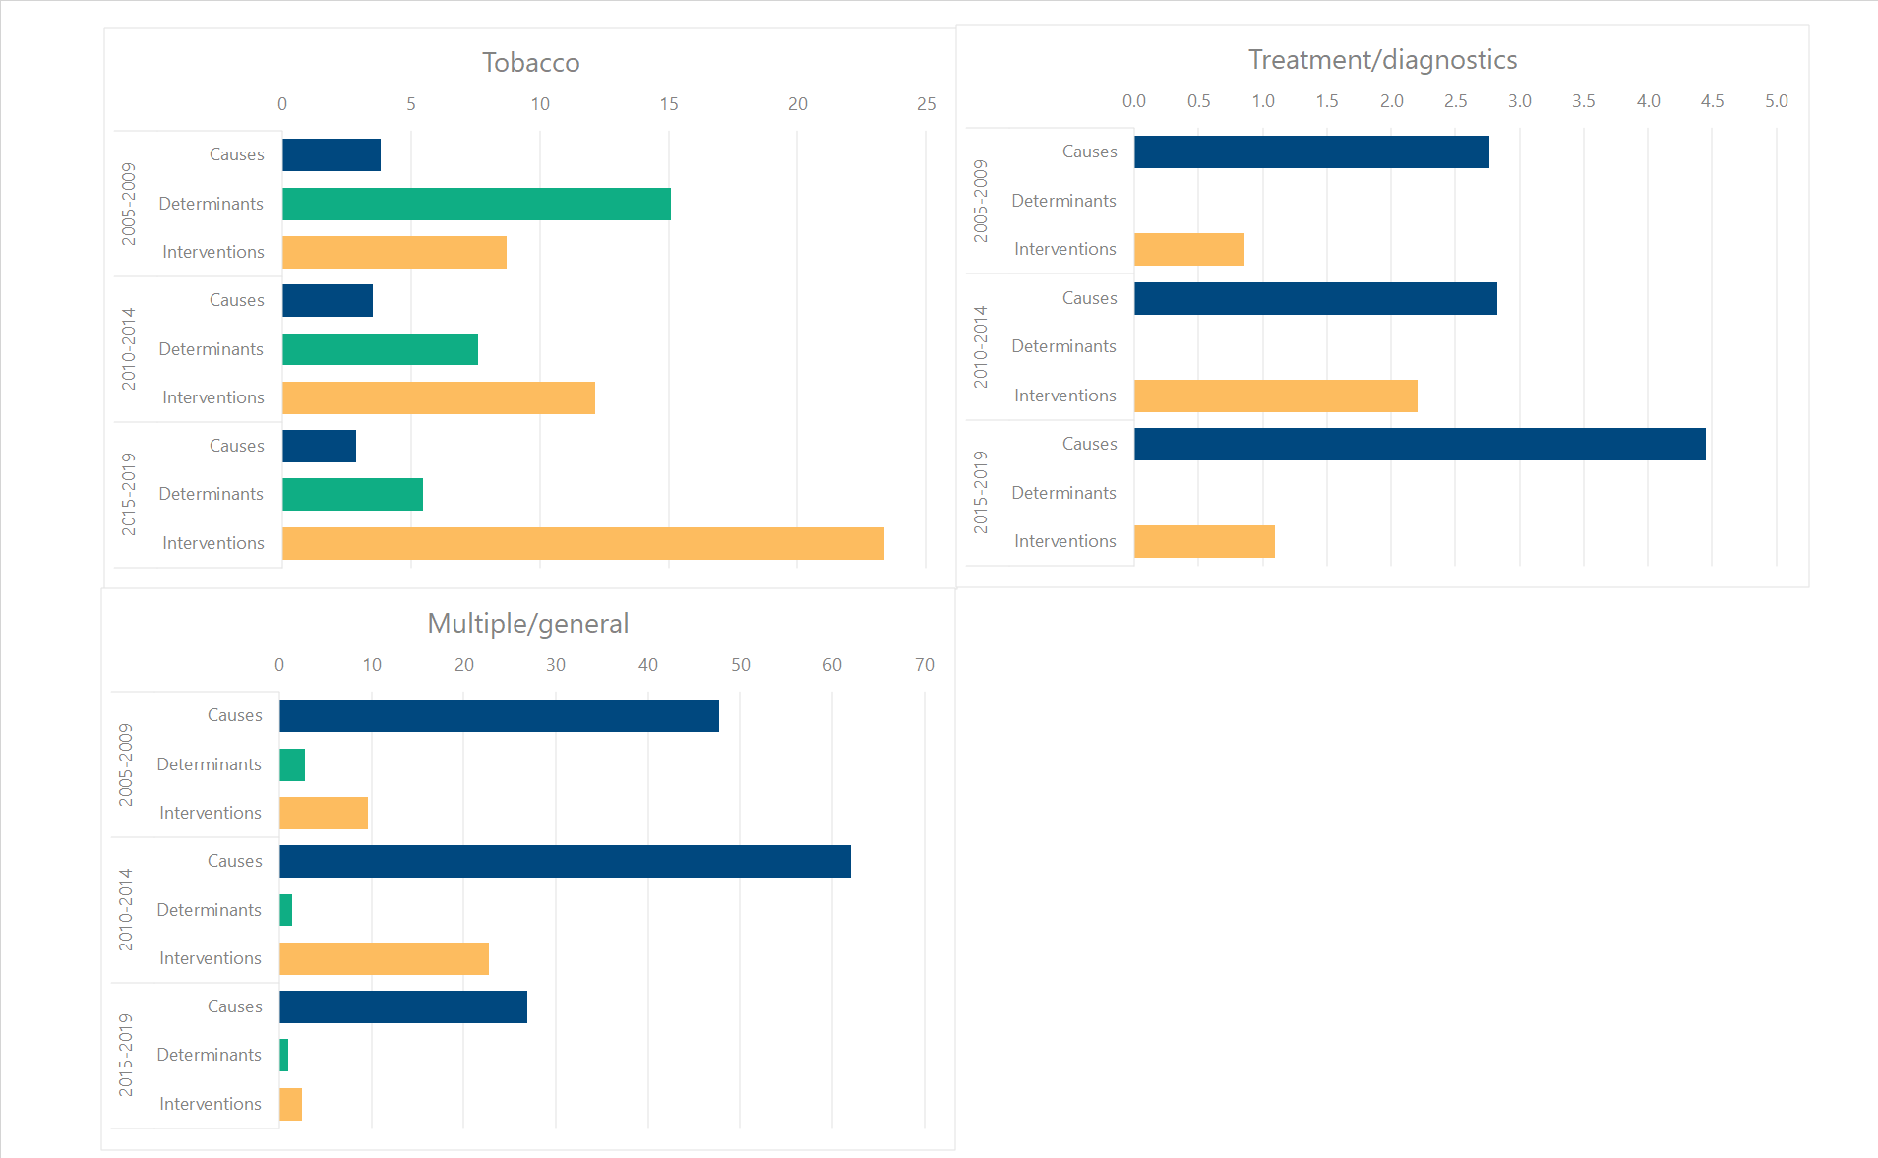
INVESTMENT BY RISK FACTOR AND RESEARCH FOCUS, THREE PERIODS ($M)
The axes vary per risk factor so the magnitude of the bars across charts is not comparable.

Slide 23
C. Nominated Principal Investigators
There were 313 nominated PIs with active research funding at some point in the last five years. When stratified by risk factors, most worked in the areas of genetic susceptibilities, infectious agents and tobacco. Half of the PIs were funded for work focused on cancer causation.
Although most trainees are supported from diverse sources like provincial or institutional programs, internships or operating grants, a small group of trainees receive awards through the grant peer-review process. Like the overall cancer risk and prevention research investment trend, the overall investment in trainee awards across levels was highest in the 2010-2014 period.

Slide 24
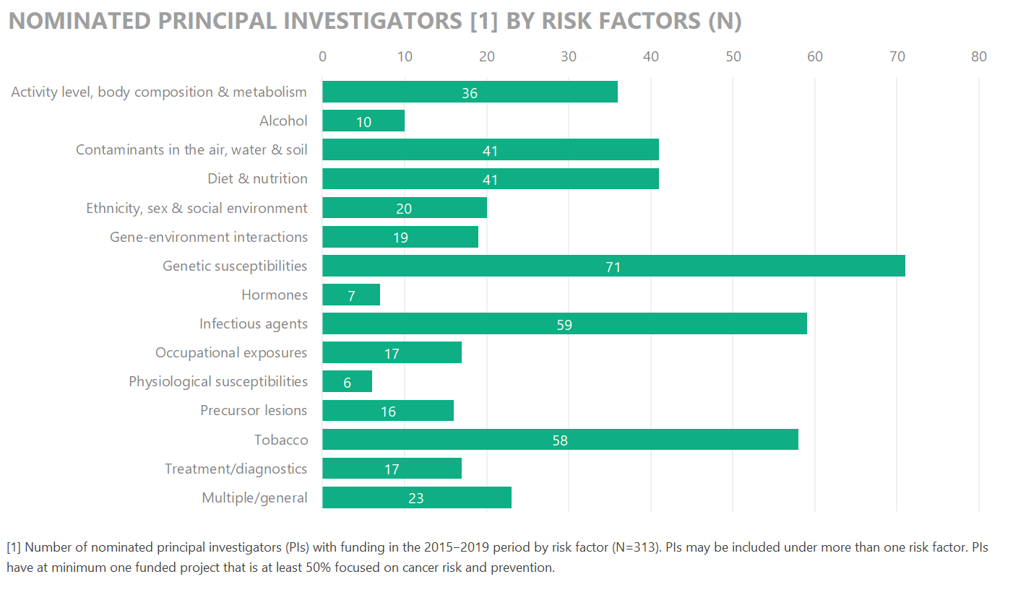

Slide 25
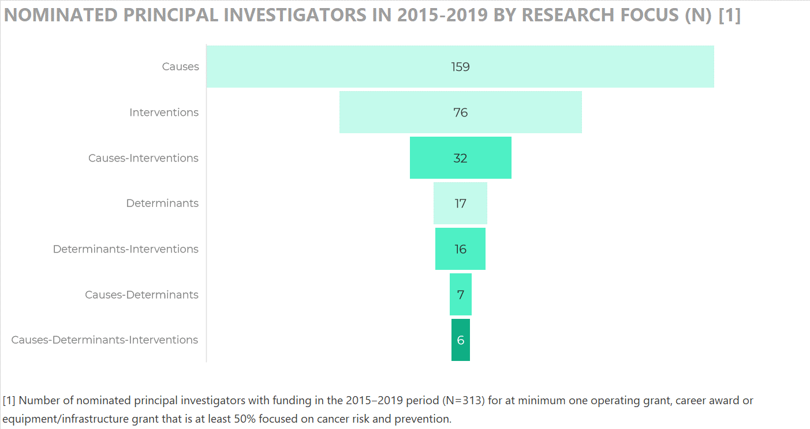

Slide 26
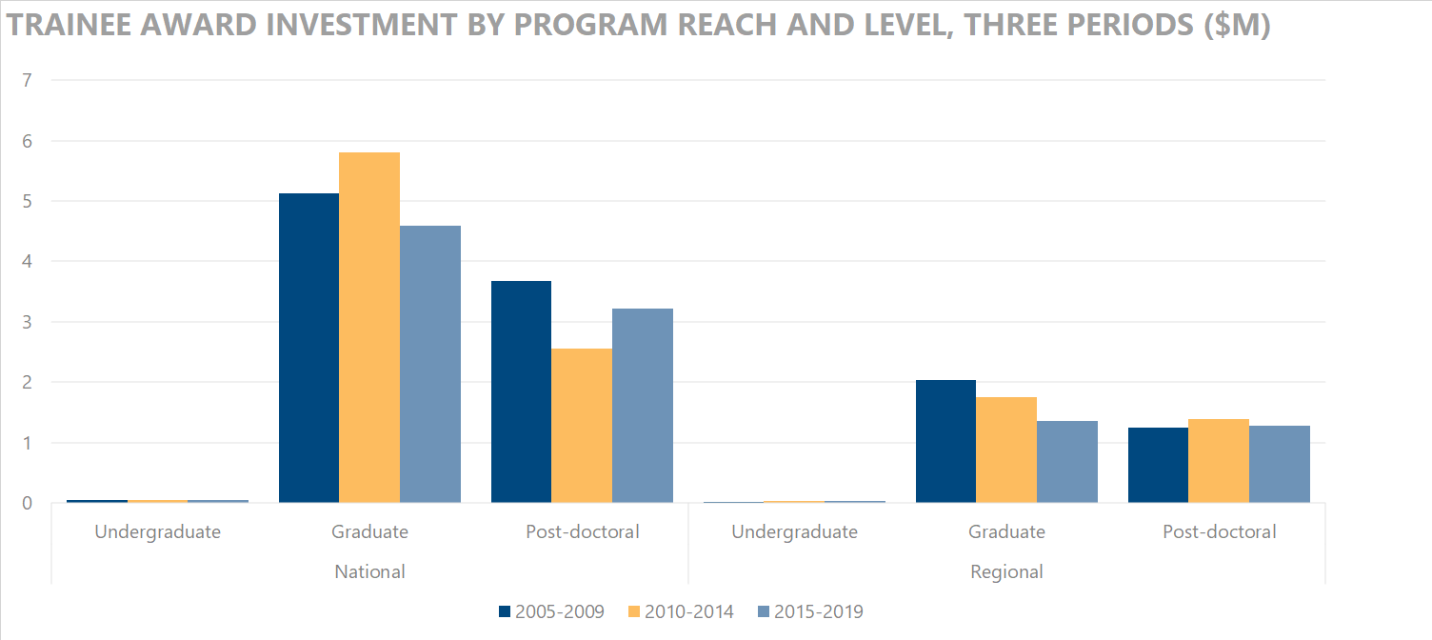

Slide 27
Further Information
The brief report, Canada’s Investment in Cancer Risk & Prevention Research, 2005–2019, is available at http://www.ccra-acrc.ca. Production of this report was made possible through collaboration and financial support from the Canadian Partnership Against Cancer Corporation and Health Canada.
Many individuals have contributed to shaping this report over the years. For this 2019 update, we are grateful to Dr. Paula Robson (Cancer Care Alberta and CCRA Chair) for her feedback.
The impetus for the original cancer risk and prevention analysis came from Dr. Jon Kerner, who was formerly the Senior Scientific Advisor for Cancer Control and Knowledge Translation at the Canadian Partnership Against Cancer.
Questions about this project should be directed to the CCRA Program Manager at info@ccra-acrc.ca.

Slide 28




 | www.ccra-acrc.ca
 | @CCRAlliance
 | linkedin.com/company/canadian-cancer-research-alliance/
 | info@ccra-acrc.ca

