Slide 1
Canada’s Investment in Cancer Survivorship Research, 2005–2019

Slide 2
Introduction
The CCRA is an alliance of organizations that collectively fund most of the cancer research conducted in Canada – research that will lead to better ways to prevent, diagnose, and treat cancer and improve survivor outcomes.
Members include federal research funding programs/agencies, provincial research agencies, provincial cancer care agencies, cancer charities, and other voluntary associations.
Member are motivated by the belief that, through effective collaboration, Canadian cancer research funding organizations can maximize their collective impact on cancer control and accelerate discovery for the ultimate benefit of Canadians affected by cancer.
The Executive Office is supported by the Canadian Partnership Against Cancer, funded by Health Canada to work with Canada’s cancer community to implement the Canadian Strategy for Cancer Control to reduce the incidence of cancer, lessen the likelihood of Canadians dying from cancer, and enhance the quality of life of those affected by cancer. The Partnership is committed to enhancing the cancer research environment in Canada through its support of the CCRA and CCRA’s role in coordinating the cancer research funding system. As a member and funder of the CCRA, the Partnership collaborates with other member organizations to enable the strategy for cancer research in Canada.

Slide 3
Why report on this investment?
An initial analysis on the investment in research on cancer survivorship that was done for the 2005 to 2008 time period. Until that time, no broad scale study of investment in cancer survivorship research in Canada existed.
Aa pan-Canadian research framework for cancer survivorship research was released in 2017 to identify priority areas for research and ways to facilitate knowledge translation. Tracking progress towards these priorities is important.
Among people living in Canada on January 1, 2015 (excluding Quebec), there were 474,050 people diagnosed with cancer from 2010 to 2014 (1,730 cases for every 100,000 people). (See https://www150.statcan.gc.ca/n1/en/daily-quotidien/191204/dq191204d-eng.pdf?st=-VGbPEkb.)

Slide 4
Methodology
The Canadian Cancer Research Survey (CCRS) was the primary data source. This is a database of over 22,000 research projects funded by 43 governmental and voluntary sector organizations for years 2005 to 2019.
3,898 projects coded entirely to CSO category 6 – Cancer Control, Survivorship and Outcomes Research, which includes patient care and survivorship code, were reviewed and either excluded or included as part of the study sample. The final sample consisted of 2,043 projects and these were coded on three dimensions: study population, research focus, and research type.
“Cancer research investment” refers to the direct funding of research projects that were administered by organizations contributing data to the survey. All projects had received some form of peer review.
Institutional affiliation of the nominated principal investigator (PI) was used for analyses based on geography (province).

Slide 5
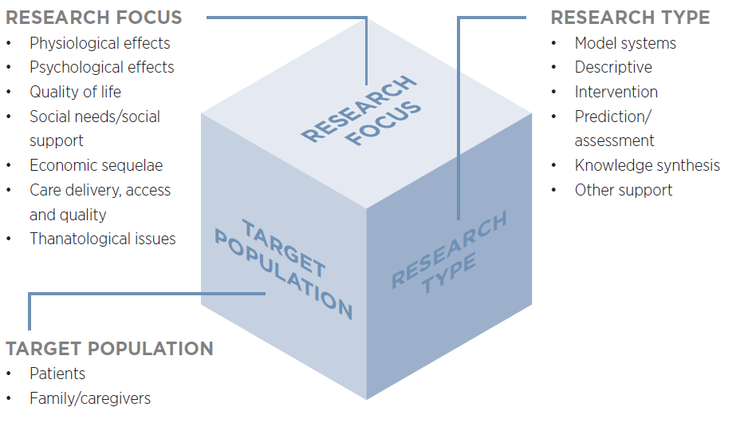
Cancer survivorship research classification
Definitions for the seven dimensions of “Research Focus” are provided on the next slide. This classification is also used for research projects related to cancer survivorship. For a full set of definitions, please consult the CCRS technical manual at https://www.ccra-acrc.ca/wp-content/uploads/2021/08/CCRS_Methods_v2021_08_24.pdf.

Slide 6
RESEARCH FOCUS - DEFINITIONS
Physiological effects: Studies identifying and managing specific late/long-term physical effects of cancer/cancer treatment (e.g., cardiovascular, respiratory, digestive, neurological, reproductive) on patients and symptoms such as pain, cachexia/anorexia, dyspnea, etc., associated with end of life.
Psychological effects: Research identifying and managing specific psychological effects (for example, depression, anxiety, distress, fear of recurrence, intimacy issues) of survivorship/end of life for patients and family /caregivers.
Quality of life: Research focused on a broad range of symptoms/outcomes rather than specific effects as identified under other foci. Includes projects focused on survivors and/or family/caregivers.
Social needs/social support: Studies on the social support needs of survivors and family/caregivers.
Economic sequelae: Studies of the economic effects of cancer for survivors and their families/caregivers. Research dealing with work/employment and vocational/educational issues are also included.
Care delivery, access and quality: Research on the ways that post-treatment and end-of-life care are delivered/organized and effects on individuals and systems. Includes evaluative studies, research on optimal care models, studies on gaps/inequities in access, costs/cost-effectiveness of care, and quality of care.
Thanatological issues Research on death/dying and the psychological mechanisms of dealing with death/ dying. Includes attitudes toward death, meaning and behaviours of bereavement and grief, and moral/ethical issues.

Slide 7
Reporting Conventions
Investment for each project was based on a prorated calculation that assumes project dollars were paid out in equal monthly instalments in accordance with project start and end dates. Project funding was calculated for the period January 1, 2005 to December 31, 2019, and averaged to yield an annual amount.
Project budgets were weighted to reflect the extent of relevance to cancer survivorship.

Slide 8
Caveats
There may be relevant research undertaken by cancer organizations and non-cancer organizations that do not participate in the CCRS. For the area of cancer survivorship, there may funding from large foundations and other organizations not captured in the CCRS that could affect the overall investment picture.
Investment figures for British Columbia may under-represent the investment in cancer survivorship research for the province because the BC Cancer Agency and its Foundation do not contribute data to the CCRS.
Given the attribution of the research investment to the location of the nominated principal investigator, geographic distribution of the investment represented herein may not be a representative account of where survivorship research has taken place.

Slide 9
A. Overall Investment
Over the fifteen years, $282.1M was invested in cancer survivorship research and this represented 3.6% of the overall cancer research investment.
The investment climbed steadily from 2005 to 2016, dipping slightly in 2017 and 2018 and re-bounding in 2019.
19% of the total cancer survivorship research investment in 2015–19 was focused on children and adolescents, slightly lower than in 2010-14.
As a collective, organizations within the federal government represented over 40% of the cancer survivorship investment regardless of the time period. Organizations within the charitable/voluntary sector accounted for 36% of the 15-year cancer survivorship research investment yet 23% of the overall cancer research investment.

Slide 13
B. Investment by Funding Organizations/ Programs
Of the 43 organizations tracked in the CCRS, 36 had some level of investment in cancer survivorship research. Much of the investment (71%), however, was made by three organizations: Canadian Institutes of Health Research (CIHR), Canadian Cancer Society (CCS), and Alberta Innovates.
CIHR represented 36% of the cancer survivorship research investment and this investment represented 5% of CIHR’s overall cancer research investment. There was $4.3M more invested by CIHR in 2015-19 than in 2010-14.
CCS represented 29% of overall 15-year cancer survivorship research investment and this investment represented 9% of CCS’s overall cancer research investment. There was $7.3M more invested by CCS in 2015-19 than in 2010-14.

Slide 14
[1] The nine organizations with the highest 15-year investments are identified by name. For funder profiles on the investment in cancer survivorship research, please consult the interactive visualization at https://www.ccra-acrc.ca/tools/cancer-survivorship-visualization/.

Slide 15
C. Investment by Funding Mechanism & Cancer Site
Over 15 years, there was a significant rise in the investment in operating grants, with the highest investments in years 2014 to 2016.
Breast cancer research represented 39% of the site-specific cancer survivorship research over the 15-year period.
The largest increased investment from the first to the third time period was found for prostate cancer, which had $12.2M more in survivorship research in 2015-19 than in 2005-09.

Slide 18
D. Investment by Research Focus & Type
From the first to the third five-year period, there were substantial increases in the investments in physiological effects ($40.0M) and care delivery, access and quality ($12.6M).
In terms of physiological effects, the research investment in cardiotoxicity/vascular issues rose by $12.2M from the first to the third period (data not shown).
In terms of type of research, the most significant shift was in terms of intervention research—$27.4M more was invested in intervention research in the 2015–19 period than the 2005-09 period.

Slide 21
E. Nominated Principal Investigators
There were 441 nominated principal investigators (PIs) who received one or more award/grant focused on survivorship over the 15 years. 59% (N=261) had received funding in 2015‒19 and they were working at institutions located in nine provinces.
Although most trainees are supported through operating grants, a small group of trainees do receive awards to facilitate completion of their research training. Of the 469 trainees granted awards over the 15-year period, 26 (6%) went on to receive one or more operating grants, equipment/infrastructure grants, or career awards.
The investment in trainee awards was $6.1M more in the 2015‒19 period than the 2005-09 period.

Slide 22
2015‒19
N=261
2010‒14
N=267
2005‒09
N=175
N=53

Slide 25
Further Information
The brief report, Canada’s Investment in Cancer Survivorship Research, 2005–2019, is available at http://www.ccra-acrc.ca. Production of this report was made possible through collaboration and financial support from the Canadian Partnership Against Cancer Corporation and Health Canada.
The Pan-Canadian Framework for Cancer Survivorship Research, published in 2017, is also available on our website. The framework identifies priority areas for investment as well as ways to facilitate knowledge translation.
Many individuals have contributed to this report since its initial development. For this 2019 update, we gratefully acknowledge the advice provided by Drs. Judy Bray (Canadian Cancer Society and Stephen Robbins and Rachel Syme (CIHR Institute of Cancer Research).
Questions about this project, should be directed to the CCRA Program Manager at info@ccra-acrc.ca.

Slide 26




 | www.ccra-acrc.ca
 | @CCRAlliance
 | linkedin.com/company/canadian-cancer-research-alliance/
 | info@ccra-acrc.ca

