Slide 1
Canada’s Investment in EARLY Translational Cancer Research, 2005–2019

Slide 2
Introduction
The CCRA is an alliance of organizations that collectively fund most of the cancer research conducted in Canada – research that will lead to better ways to prevent, diagnose, and treat cancer and improve survivor outcomes.
Members include federal research funding programs/agencies, provincial research agencies, provincial cancer care agencies, cancer charities, and other voluntary associations.
Member are motivated by the belief that, through effective collaboration, Canadian cancer research funding organizations can maximize their collective impact on cancer control and accelerate discovery for the ultimate benefit of Canadians affected by cancer.
The Executive Office is supported by the Canadian Partnership Against Cancer, funded by Health Canada to work with Canada’s cancer community to implement the Canadian Strategy for Cancer Control to reduce the incidence of cancer, lessen the likelihood of Canadians dying from cancer, and enhance the quality of life of those affected by cancer. The Partnership is committed to enhancing the cancer research environment in Canada through its support of the CCRA and CCRA’s role in coordinating the cancer research funding system. As a member and funder of the CCRA, the Partnership collaborates with other member organizations to enable the strategy for cancer research in Canada.

Slide 3
Why report on this investment?
There is increasing emphasis on identifying ways to “translate” research and accelerate the speed at which the public start to benefit from research advances.
Canada’s cancer research funders are interested in identifying gaps and potential bottlenecks to early translational research as well as prospective solutions that will improve and expedite the implementation of innovative findings from “bench to bedside” and, where applicable, “bedside to bench” in this iterative process.
For the purposes of this report, early translational research refers to research that confirms and advances discoveries into tangible modalities (pre-clinical) and tests modalities in the clinic (early phase clinical trials). Implementation research, which is designed to transfer clinical findings to practice settings and communities, is excluded from this report.
3

Slide 4
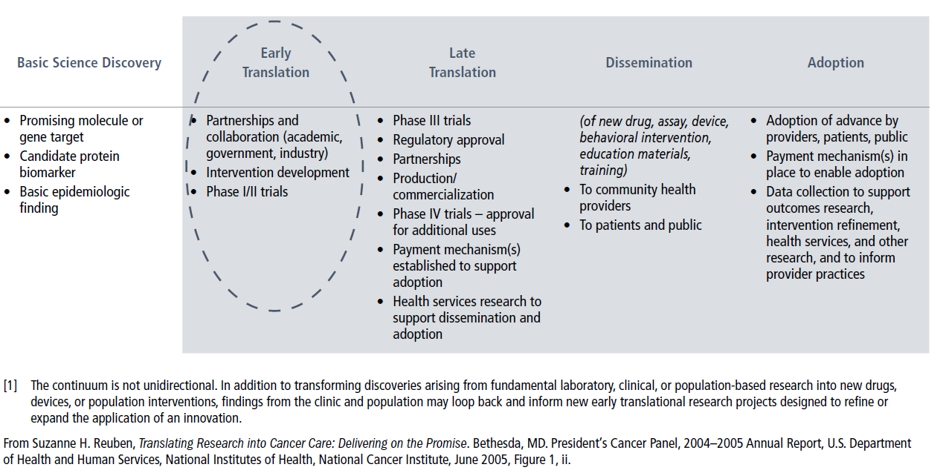
Research Translation Continuum [1]
4

Slide 5
Methodology
The Canadian Cancer Research Survey (CCRS) was the primary data source. This database contains over 27,000 research projects funded by 43 governmental and voluntary sector organizations/programs for years 2005 to 2019.
Projects coded to CSO categories, Early detection, diagnosis and prognosis and Treatment, were all included and coded to the appropriate modality. Prevention and Cancer survivorship research was also included when the research involved a specific modality. Projects were classified using the TRWG-adopted framework on the following slide.
Funding for major initiatives that supported networks or platforms for translational research were also included and stratified by modality category, not specific modality.
Of note, data from the National Research Council Canada was excluded from the analysis because of a data gap for years 2011 to 2015, which affects the analysis when stratified by time periods.
5

Slide 6
6

Slide 7
Reporting Conventions
“Cancer research investment” refers to the direct funding of research projects that were administered by organizations contributing data to the survey. All projects had received some form of peer review.
Investment for each project was based on a prorated calculation that assumes project dollars were paid out in equal monthly instalments in accordance with project start and end dates. Project funding was calculated for the period January 1, 2005 to December 31, 2019 and analyzed by three five-year periods (i.e., 2005‒09, 2010‒14, and 2015‒19).
Project budgets are weighted to reflect the extent of relevance to early translational cancer research and allocated to the relevant modality in the framework.
8

Slide 8
Caveats
Research undertaken by industry is not part of the CCRS and likely accounts for large investments in early translational research, particularly drug research. Hospital foundations and cancer research funders from outside of Canada are also funding sources for early translational research projects not captured in the report. Foundations with large research investments, such as those located in Ontario, Quebec and B.C. are a major omission.
There are coding challenges in delineating phases of clinical trials and on ascribing relevance to early translational research.
Project classification is reliant on the quality of the research descriptions provided by the funding organizations.
9

Slide 9
A1. Overall Investment
From 2005 to 2019, a total of $3.1 billion was invested in early translational cancer research. There were 10,760 projects with at least some early-stage translational research component.
The substantive rise in the investment in 2009 was attributable to the ramp-up of the Ontario Institute for Cancer Research (OICR) as well as increased investment in infrastructure through major initiatives administered by the Canada Foundation for Innovation (CFI).
Early translational research investment represented 34% of the overall cancer research investment in 2005 and 52% in 2019.
The growth in investment from 2005–09 to 2015–19 was largely the result of increased investment in drugs and biologics (agents) and biomarkers (biospecimen-based risk assessment).
10

Slide 10
A2. Overall Investment
Modalities (as per the classification) varied in terms of investment from period to period.
Pre-clinical research formed the largest part of the investment regardless of modality and this was particularly the case for drug research.
The largest investment in terms of major initiatives was for interventions, with much of this investment focused on supporting drug research. The investment in major initiatives was didn’t vary substantively from period to period.
Although not captured in the investment figures, biorepositories are key to supporting translational cancer research.
10

Slide 11
12

Slide 13
13

Slide 15
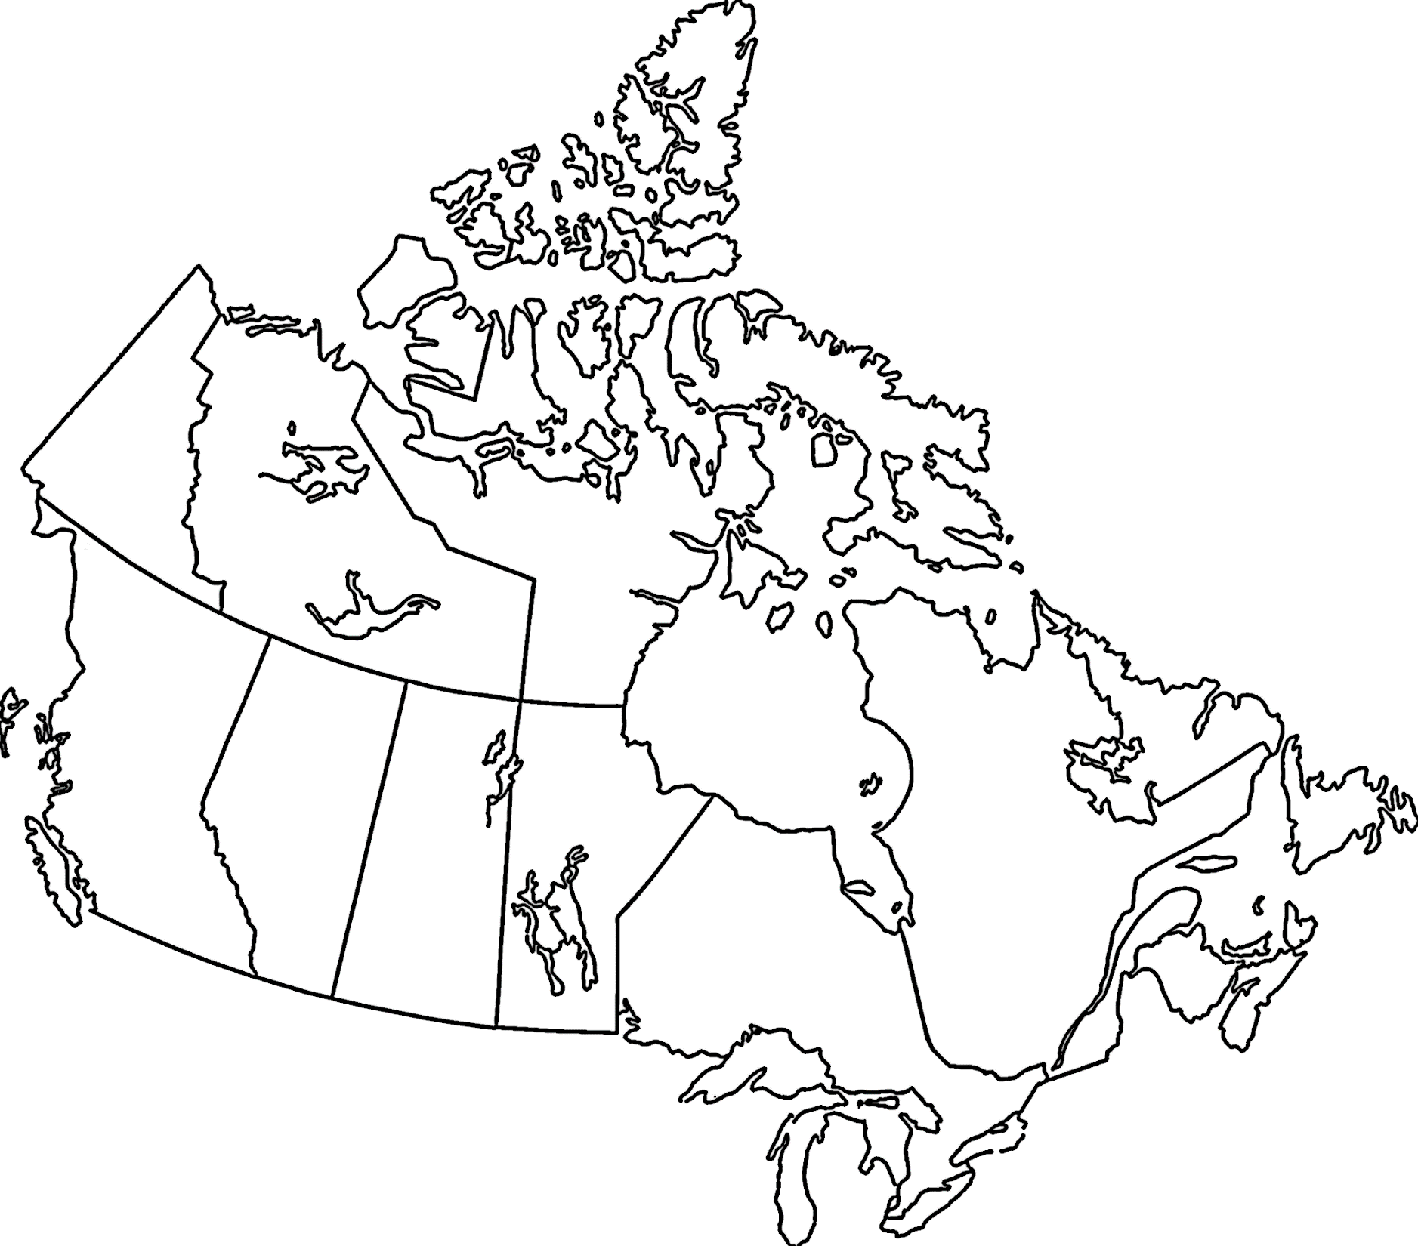

Slide 16
B. Organization-specific Investment
41% of the 15-year investment in early translational research (including major initiatives) came from the Federal government sector. The investment from the voluntary sector (charities and non-profit associations), however, showed the greatest growth (percent change) from the first to the third five-year period.
All organizations covered in the CCRS had some investment in early translational research, be it research funding or supporting infrastructure such as biorepositories. However, the modality-specific investment was largely from a few funding organizations. In fact, 62% of the overall 15-year modality-specific investment was made by: Canadian Institutes of Health Research (CIHR), Ontario Institute for Cancer Research (OICR), Canadian Cancer Society (CCS), The Terry Fox Research Institute (TFRI) and Natural Sciences and Engineering Research Council (NSERC). To access more information on the investments by funders, please consult our interactive visualization on the CCRA website.
16

Slide 17
17

Slide 19
C. Site-specific Investment
One dollar in every $5 invested in site-specific early translational cancer research over the 15 years was for research relevant to breast cancer.
The increased investment in early translational cancer research from the first to the third five-year period was $40M or more for research relevant to leukemias (↑ $66.2M), and brain (↑ $53.9M), breast (↑ $48.9M), and prostate cancers (↑ $41.6M).
There were slight variations in the rankings of site-specific investments when stratified by modality. To access this information, please consult our interactive visualization on the CCRA website.
19

Slide 21
D. Nominated Principal Investigators
In the 2015‒19 period, there were 1,080 nominated (lead) principal investigators (PI) with at least one or more operating grant, career award, or equipment grant with an early translational research weighting of 100%. More than half of these researchers were funded for interventive research.
65% of the nominated PIs in the 2015-19 period were from Ontario or Quebec.
Although most trainees are supported from diverse sources like provincial or institutional programs, internships or operating grants, a small group of trainees receive awards through the grant peer-review process. Over the 15 years, 2,234 trainees received funding for early translational research projects. Of these, 82 went on to receive grants as nominated PIs.
The investment in trainee awards grew for both national and regional funders for each successive time period.
21

Slide 25
E1. Investment by Province
The research investment is based on the provincial affiliation of the nominated principal investigator. Provincial populations were used to normalize the research investment data.
The highest per capita investments for the 15-year period were found in Ontario, British Columbia, and Quebec. Principal investigators (PI) in these provinces were most often the nominated PIs who received funding for major initiatives.
23

Slide 26
E2. Investment by Province
There were modality-specific differences. In 2015‒19, the per capita investments exceeded the national average for:
  Ontario and B.C. for drugs and biologics (agents)
  Ontario and Nova Scotia for immunotherapies (immune response modifiers)
  Ontario and Alberta for devices (interventive devices)
  Ontario and B.C. for biomarkers (biospecimen-based risk assessment)
  Ontario and B.C. for imaging (image-based risk assessment)
23

Slide 28
Further Information
A brief electronic report, Canada’s Investment in Early Translational Cancer Research, 2005–2019, and an interactive dashboard are available at http://www.ccra-acrc.ca. Production of this report was made possible through collaboration and financial support from the Canadian Partnership Against Cancer Corporation and Health Canada.
This report would not have been possible without the advice provided by Drs. Anne-Marie Mes-Masson (Institut du cancer de Montréal, CRCHUM), Christine Williams (Ontario Institute for Cancer Research), and Jim Woodgett (Terry Fox Research Institute).
The impetus for the original early translational research analysis came from Dr. Victor Ling, founding President and inaugural Scientific Director of The Terry Fox Research Institute, and recognizes the organization’s pioneering role in support of early translational research in Canada.
Questions about this project should be directed to the CCRA Program Manager at info@ccra-acrc.ca.
25

Slide 29




 | www.ccra-acrc.ca
 | @CCRAlliance
 | linkedin.com/company/canadian-cancer-research-alliance/
 | info@ccra-acrc.ca

