Slide 1
Canada’s Investment in Cancer Survivorship Research, 2005–2021

Slide 2
Introduction
The CCRA is an alliance of organizations that collectively fund most of the cancer research conducted in Canada – research that will lead to better ways to prevent, diagnose, and treat cancer and improve survivor outcomes.
Members include federal research funding programs/agencies, provincial research agencies, provincial cancer care agencies, cancer charities, and other voluntary associations.
Member are motivated by the belief that, through effective collaboration, Canadian cancer research funding organizations can maximize their collective impact on cancer control and accelerate discovery for the ultimate benefit of Canadians affected by cancer.
The Executive Office is supported by the Canadian Partnership Against Cancer, funded by Health Canada to work with Canada’s cancer community to implement the Canadian Strategy for Cancer Control to reduce the incidence of cancer, lessen the likelihood of Canadians dying from cancer, and enhance the quality of life of those affected by cancer. The Partnership is committed to enhancing the cancer research environment in Canada through its support of the CCRA and CCRA’s role in coordinating the cancer research funding system. As a member and funder of the CCRA, the Partnership collaborates with other member organizations to enable the strategy for cancer research in Canada.

Slide 3
Why report on this investment?
An initial analysis on the investment in research on cancer survivorship that was done for the 2005 to 2008 time period. Until that time, no broad scale study of investment in cancer survivorship research in Canada existed.
Aa pan-Canadian research framework for cancer survivorship research was released in 2017 to identify priority areas for research and ways to facilitate knowledge translation. Tracking progress towards these priorities is important.
As of January 1, 2018, more than 1.5M people in Canada had received a cancer diagnosis in the previous 25 years and were still alive on that date (See https://cdn.cancer.ca/-/media/files/research/cancer-statistics/2022-statistics/2022-special-report/2022_prevalence_report_final_en.pdf.)

Slide 4
Methodology
The Canadian Cancer Research Survey (CCRS) was the primary data source. This is a database of over 30,000 research projects funded by 45 governmental and voluntary sector organizations for years 2005 to 2021.
4,345 projects coded entirely to CSO category 6 – Cancer Control, Survivorship and Outcomes Research, which includes patient care and survivorship code, were reviewed and either excluded or included as part of the study sample. The final sample consisted of 2,298 projects and these were coded on three dimensions: study population, research focus, and research type.
“Cancer research investment” refers to the direct funding of research projects that were administered by organizations contributing data to the survey. All projects had received some form of peer review.
Institutional affiliation of the nominated principal investigator (PI) was used for analyses based on geography (province).

Slide 5
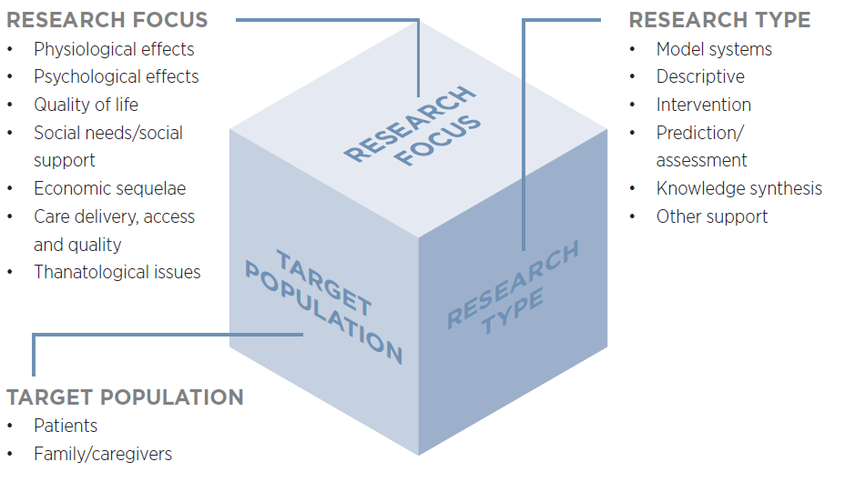
Cancer survivorship research classification
Definitions for the seven dimensions of “Research Focus” are provided on the next slide. This classification is also used for research projects related to cancer survivorship. For a full set of definitions, please consult the CCRS technical manual at https://www.ccra-acrc.ca/reports/.

Slide 6
RESEARCH FOCUS - DEFINITIONS
Physiological effects: Studies identifying and managing specific late/long-term physical effects of cancer/cancer treatment (e.g., cardiovascular, respiratory, digestive, neurological, reproductive) on patients and symptoms such as pain, cachexia/anorexia, dyspnea, etc., associated with end of life.
Psychological effects: Research identifying and managing specific psychological effects (for example, depression, anxiety, distress, fear of recurrence, intimacy issues) of survivorship/end of life for patients and family /caregivers.
Quality of life: Research focused on a broad range of symptoms/outcomes rather than specific effects as identified under other foci. Includes projects focused on survivors and/or family/caregivers.
Social needs/social support: Studies on the social support needs of survivors and family/caregivers.
Economic sequelae: Studies of the economic effects of cancer for survivors and their families/caregivers. Research dealing with work/employment and vocational/educational issues are also included.
Care delivery, access and quality: Research on the ways that post-treatment and end-of-life care are delivered/organized and effects on individuals and systems. Includes evaluative studies, research on optimal care models, studies on gaps/inequities in access, costs/cost-effectiveness of care, and quality of care.
Thanatological issues Research on death/dying and the psychological mechanisms of dealing with death/ dying. Includes attitudes toward death, meaning and behaviours of bereavement and grief, and moral/ethical issues.

Slide 7
Reporting Conventions
Investment for each project was based on a prorated calculation that assumes project dollars were paid out in equal monthly instalments in accordance with project start and end dates. Project funding was calculated for the period January 1, 2005 to December 31, 2021, and averaged to yield an annual amount.
Project budgets were weighted to reflect the extent of relevance to cancer survivorship.

Slide 8
Caveats
There may be relevant research undertaken by cancer organizations and non-cancer organizations that do not participate in the CCRS. For the area of cancer survivorship, there may funding from large foundations and other organizations not captured in the CCRS that could affect the overall investment picture.
Investment figures for British Columbia may under-represent the investment in cancer survivorship research for the province because the BC Cancer Agency and its Foundation do not contribute data to the CCRS.
Given the attribution of the research investment to the location of the nominated principal investigator, geographic distribution of the investment represented herein may not be a representative account of where survivorship research has taken place.

Slide 9
A. Overall Investment
Over the 17 years, $340M was invested in cancer survivorship research and this represented 4% of the overall cancer research investment.
Investments climbed steadily from 2005 to 2016, dipped in 2017 and 2018, re-bounded in 2019, and rose substantively in 2020 and 2021.
22% of the total cancer survivorship research investment in 2017–21 was focused on children and adolescents.
As a collective, organizations within the federal government represented over 40% of the cancer survivorship investment regardless of the period. The charitable sector, however, accounted for a higher proportion of the cancer survivorship research investment than it did in terms of the overall cancer research investment.

Slide 13
B. Investment by Funding Organizations/ Programs
Of the 45 organizations tracked in the CCRS, 40 had some level of investment in cancer survivorship research. Well over half of the investment (61%), however, was made by two organizations: the Canadian Institutes of Health Research (CIHR) and the Canadian Cancer Society (CCS).
Over the 17 years, CIHR represented 38% of the cancer survivorship research investment and this investment represented 5% of CIHR’s overall cancer research investment. There was $24.5M more invested by CIHR in 2017-21 than in 2007-11.
CCS represented 23% of overall 17-year cancer survivorship research investment and this investment represented 9% of CCS’s overall cancer research investment. There was $3.5M more invested by CCS in 2017-21 than in 2007-11.

Slide 14
[1] The ten organizations with the highest 17-year investments are identified by name. For funder profiles on the investment in cancer survivorship research, please consult the interactive visualization at https://www.ccra-acrc.ca/tools/cancer-survivorship-visualization/.
[2] Alberta Innovates did not submit data for years 2020 and 2021.

Slide 15
C. Investment by Funding Mechanism & Cancer Site
The trend over the 17 years was dictated by the trend in investment in operating grants.
Regardless of period, the largest proportion of the cancer survivorship research investment was focused on breast cancer.
Increases in investment from the first to second period were notable for prostate cancer and leukemias. From the first to the third period, there was a more than fourfold increase in the research investment on ovarian cancer.

Slide 18
D. Investment by Research Focus & Type
From the first to the latest five-year period, there were substantial increases in the research investments on physiological effects ($37M), and care delivery, access, and quality ($20M).
In terms of physiological effects, the highest increased investment was on research related to cardiotoxicity/vascular issues ($12M (data not shown).
Testing of new approaches to support cancer survivors is critically important. Four of every $10 invested in cancer survivorship research in 2021 involved interventions.

Slide 21
E. Nominated Principal Investigators
523 nominated principal investigators (PI) received one or more award/grant focused on survivorship over the 17 years. There were 280 nominated PIs with funded for research projects during the 2017–21 period and a large percentage (48%) were working in institutions in Ontario.
Although most trainees are supported through operating grants, a small group of trainees do receive awards to facilitate completion of their research training. Of the 560 trainees granted awards over the 17 years, 34 (6%) went on to receive one or more operating grants, equipment/infrastructure grants, or career awards.
The investment in trainee awards focused on survivorship research was $5M more in the 2017‒21 period than the 2007-11 period.

Slide 22
2017‒21
N=280
2012‒16
N=292
2007‒11
N=245
N=80

Slide 25
Further Information
The brief report, Canada’s Investment in Cancer Survivorship Research, 2005–2021, is available at http://www.ccra-acrc.ca. Production of this report was made possible through collaboration and financial support from the Canadian Partnership Against Cancer Corporation and Health Canada. Many individuals have contributed to this report since its initial development.
The Pan-Canadian Framework for Cancer Survivorship Research, published in 2017, is also available on our website. The framework identifies priority areas for investment as well as ways to facilitate knowledge translation.
Questions about this project, should be directed to the CCRA Program Manager at info@ccra-acrc.ca.

Slide 26




 | www.ccra-acrc.ca
 | @CCRAlliance
 | linkedin.com/company/canadian-cancer-research-alliance/
 | info@ccra-acrc.ca

